Slide 1
Team Delivery Practices
A Module in Agile Fundamentals
Notes:
Welcome to Quality, a module in Agile Fundamentals. This module is brought to you by Twist, the testing platform from ThoughtWorks Studios.
In this module, we’ll explore the concepts of Quality in Agile Software Development, when it is applied, how it is applied, and how it affects the end result.

Slide 2

Module Acceptance Criteria
Be able to recognize smells
Understand how we “bake quality in” to the agile project
Understand the use of acceptance criteria
Understand the role of automation
Understand how and why we pair
Define refactoring and why it is done
Learn about test-driven development
Understand the role of continuous integration

Slide 3
Understanding Smells
Notes:
Let’s move on to something kind of stinky – smells! There are process smells and code smells and situation smells and all sorts of smells.

Slide 4
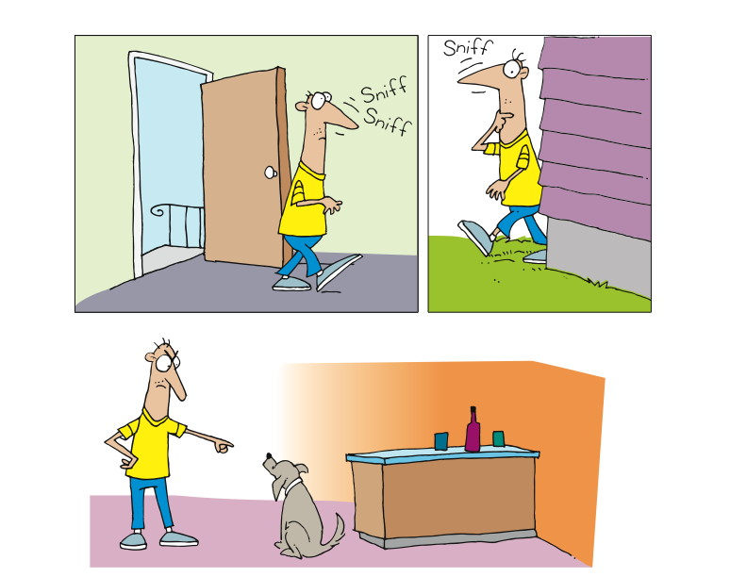
Notes:
Read definition
Walk into your home and something doesn’t smell right.
You walk around to try to find the culprit. Garbage, Laundry, Fido?
Smells are subtle
The smell is not the problem, its what’s causing the smell
Once you identify it, you can do something about it.
------------------------------------------------------------------------------------------------------------------------
As usual, let’s start with a defnition:
“In computer programming, code smell is any symptom in the source code of a program that possibly indicates a deeper problem.
“Often the deeper problem hinted by a code smell can be uncovered when the code is subjected to a short feedback cycle where it is refactored in small, controlled steps, and the resulting design is examined to see if there are any further code smells that indicate the need of more refactoring. From the point of view of a programmer charged with performing refactoring, code smells are heuristics to indicate when to refactor, and what specific refactoring techniques to use. Thus, a code smell is a driver for refactoring.”
http://en.wikipedia.org/wiki/Code_smell
[CLICK]
To get the idea of smells, imagine walking into your home, and you realize that something stinks. Literally. You smell something, and you know it’s not right, but you’re not sure what it is. Gas? Garbage? Dirty laundry? Whatever it is, it’s the smell that leads you to explore and eventually to discover the source of the smell.
Smells are subtle, in that it’s not the smell itself that’s the problem, but rather what the smell indicates about something deeper or bigger.
Once you’ve discovered the source of a smell, you can do something about it.

Slide 5
Examples of Code Smells
Long Methods
Explaining Comments
Magic Numbers
Notes:
Remember that Smells are merely a way to recognize potential refactorings
Long Methods suggest Extract Method
Explaining Comments – suggest extract method and remove comments
Magic Numbers - An unnamed or ill-documented numerical constant value. From wikipedia.
“Refactoring to Patterns” by Joshua Kerievsky is an excellent resource for developers looking for ways to identify smells and their suggested refactorings

Slide 6
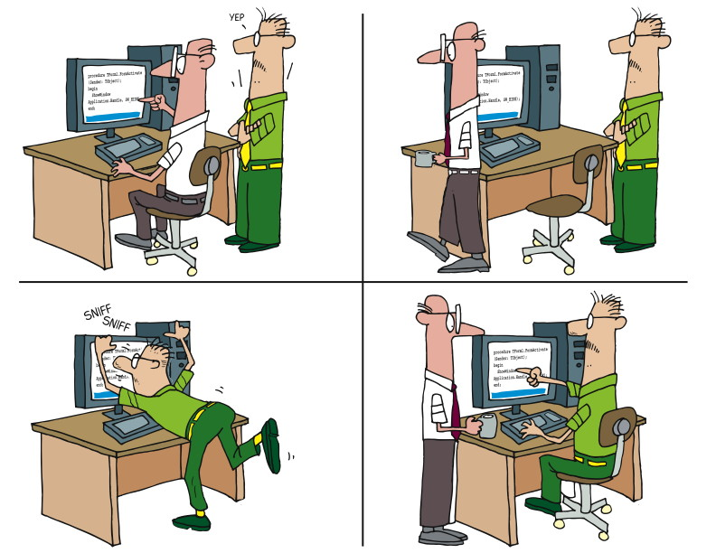
Pairing and Smells
Notes:
Let’s go back to the hygiene issue
You work out. You can’t really smell yourself, because you’ve been – immersed in it.
Consider what happens when you work by yourself.
You may not notice the smells you are creating.
Pairing helps
Looking back at our discussion about pairing, we can see where smells come into play.
Forgive the somewhat graphic discussion, but consider what happens when you exercise. Typically, if you’re exercising hard, or working hard, you’ll sweat. When you sweat, you sometimes produce an unpleasant odor. And yet we generally cannot smell our own odor at that time, because we’ve been – if you will – immersed in it.
Now consider what happens when you work by yourself. You might do something that’s just a little bit less than optimal. Then as you continue to build on that, the suboptimization subtly increases, you being all unaware because you’ve been immersed in it all along.
Just as with the gentle aroma that comes from heavy exercise, you may be producing code smells. Without the presence of someone else to – sniff – help you identify those smells, you might go along happily thinking all is good. That’s where pairing comes in.

Slide 7
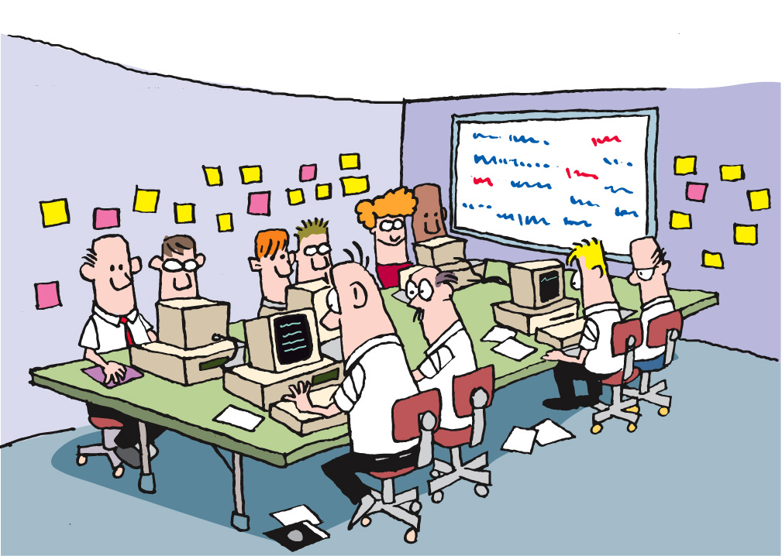
Team Smells
Notes:
Team smells
Someone with headphones
May not be a smell, but worth investigating
Same pair all the time
Regular issues with one BA’s stories
-----------------------------------------------------------------------------------------
Let’s also consider a different form of smell – team smells. Imagine that you have a collocated team. As you walk into the team room, you notice that one member of the team has headphones on and is bopping along to some music that only they can hear. Everyone seems happy, most of the team is pairing, work is getting done, and yet…
That team member with the headphones on is a team smell. Why? One of the keys to success on an agile team is ongoing communication and osmotic learning. Osmotic learning is the learning that takes place when conversations and discussions are going on, and I learn just by overhearing. And, of course, I may hear something that stimulates me to jump in and contribute. The team dynamics on Agile teams are exciting, because there’s so much communication going on.
So if you have a team member with headphones on, they’re disconnected from the rest of the team, isolated from any osmotic learning, and not contributing to the life of the team.
It’s not NECESSARILY a bad thing. But as with any smell, it’s worth investigating.

Slide 8
What is Quality?
Notes:
2 key principles
Fit for purpose
Right first time
Determined by the intended user
-----------------------------------------------------------------------------------------------
Once again, let’s start with some definition.
First, what is Quality in a business or engineering environment?
From Wikipedia, we get this definition:
Quality in business, engineering and manufacturing has a pragmatic interpretation as the non-inferiority or superiority of something. Quality is a perceptual, conditional and somewhat subjective attribute and may be understood differently by different people. Consumers may focus on the specification quality of a product/service, or how it compares to competitors in the marketplace. Producers might measure the conformance quality, or degree to which the product/service was produced correctly.
And also from Wikipedia, we get a definition of Quality Assurance:
Quality assurance, or QA for short, refers to planned and systematic production processes that provide confidence in a product's suitability for its intended purpose. It is a set of activities intended to ensure that products (goods and/or services) satisfy customer requirements in a systematic, reliable fashion. QA cannot absolutely guarantee the production of quality products, unfortunately, but makes this more likely.
Two key principles characterize QA: "fit for purpose" (the product should be suitable for the intended purpose) and "right first time" (mistakes should be eliminated). QA includes regulation of the quality of raw materials, assemblies, products and components; services related to production; and management, production and inspection processes.
It is important to realize also that quality is determined by the intended users, clients or customers, not by society in general: it is not the same as 'expensive' or 'high quality'. Even goods with low prices can be considered quality items if they meet a market need.

Slide 9
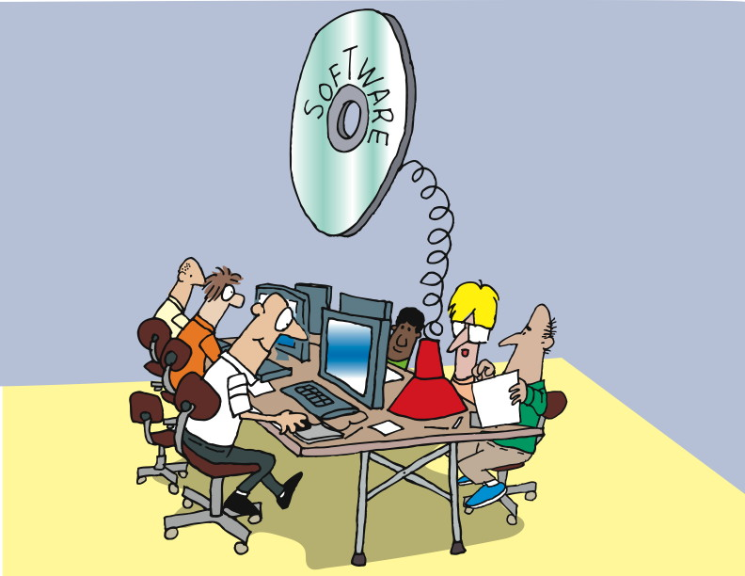
Introduction
Notes:
Software Craftsmanship movement
Requires certain skills and disciplines to do it well
Agile has some best practices as well
--------------------------------------------------------------------------
Some of you may have heard of the Software Craftsmanship movement. Whether you believe that software development is a craft, a profession, an art, or magic, what’s important to think about is that in most cases, software development – like any skilled activity – requires certain disciplines and skills to do it well.
In the Agile world, there are a number of practices that have become best practices, as they are likely to contribute to successfully building, deploying, and maintaining software.
Let’s begin with one of the hardest for most developers to adopt: test-driven development, or TDD.

Slide 10
Quality in business, engineering and manufacturing has a pragmatic interpretation as the non-inferiority or superiority of something. Quality is a perceptual, conditional and somewhat subjective attribute and may be understood differently by different people. Consumers may focus on the specification quality of a product/service, or how it compares to competitors in the marketplace. Producers might measure the conformance quality, or degree to which the product/service was produced correctly.
Notes:
Let’s take a look at the word Quality from Wikipedia.
Read through the whole slide. Slowly.

Slide 11
Quality assurance, or QA for short, refers to planned and systematic production processes that provide confidence in a product's suitability for its intended purpose. It is a set of activities intended to ensure that products (goods and/or services) satisfy customer requirements in a systematic, reliable fashion. QA cannot absolutely guarantee the production of quality products, unfortunately, but makes this more likely.
Two key principles characterize QA: "fit for purpose" (the product should be suitable for the intended purpose) and "right first time" (mistakes should be eliminated). QA includes regulation of the quality of raw materials, assemblies, products and components; services related to production; and management, production and inspection processes.
It is important to realize also that quality is determined by the intended users, clients or customers, not by society in general: it is not the same as 'expensive' or 'high quality'. Even goods with low prices can be considered quality items if they meet a market need.
Notes:
Talk specifically about QA.
Read the first sentence.
Point out ‘fit for purpose’ and ‘right first time’.

Slide 12
Who owns quality?
Program
Manager
Project Manager
Enterprise Architect
Core
Team
Project Sponsor
Iteration Manager
Tech
lead
Business Analyst
Infra. Lead
Application Owner
Tester
Bus. SME
Architect
Software
Engineer
Other key stakeholders
Support
Analyst
Extended Team
Notes:
Entire team’s responsibility.
Initially hard for everyone to understand how they are responsible.
Let’s take a look.
------------------------------------------------------------------------------------------------------------------
Quality is the entire core team’s responsibility not any one individual, or even any one capability. It is the job of the team leadership to ensure everyone is aware of their responsibility towards quality. This is possibly one of the oldest cultural hurdles to clear when attempting to work in an Agile fashion. The notion of Analysts and Developers being equal partners in owning the quality in an Agile project will be anathema to many people unfamiliar with this way of working.

Slide 13
How we focus on quality
I automate the application of quality metrics against the codebase
I make sure resources are being used to address the most pressing issues for the team
Core
Team
Iteration Manager
I insist on being involved early in the project to ensure infrastructure requirements are captured
I ensure acceptance criteria are created for all stories
Tech
lead
Business Analyst
Infra. Lead
Tester
I make myself available frequently to see work in progress development
I work with team members to catch defects early, or prevent them happening at all
Bus. SME
Architect
Software
Engineer
I validate my design with working code, not pretty pictures
I don’t write a line of production code without an automated test around it
Notes:
Read through how each role contributes to quality of an application.
---------------------------------------------------------------------------------------------------------------------------
Of course, just stating that each person on an Agile team is responsible for overall quality doesn’t make it so. To back up the desire for a shared commitment to quality, many of the practices that the different roles play, and perhaps even more importantly, the time that they undertake these activities, all support the desire for quality to be collectively owned.
Note that for many of the roles, there are numerous other examples of a quality focus within an Agile team.

Slide 14
Types of Testing
Notes:
We will not define the different types of testing,
but we’ll discuss the difference between testing in Agile and testing in the traditional sense.

Slide 15
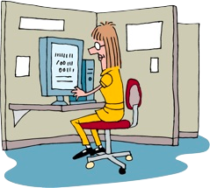
Types of Testing
Unit Testing
Notes:
Also known as white box or glass box testing
involves testing each module/class as it is developed
Agile approach
Emphasise unit testing
Automation
Foundational
Not a “phase”
Traditional approach
Little focus
Insufficient effort

Slide 16
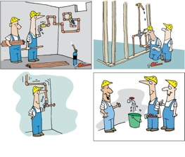
Types of Testing
Unit Testing
Acceptance Testing
Notes:
focused on testing the functionality of the application (including negative and boundary conditions).
Agile approach
As early as possible
Every story has acceptance criteria
Test Analysts map code to acceptance criteria
Traditional Approach
Testing starts here
After developers are done

Slide 17
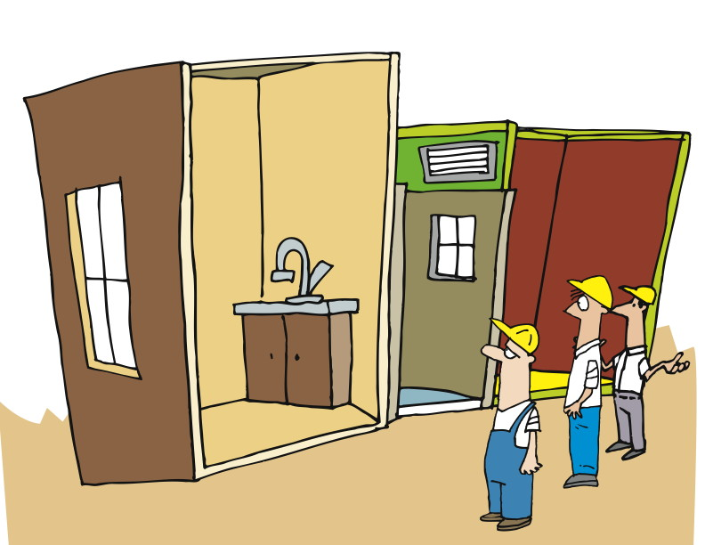
Types of Testing
Unit Testing
Acceptance Testing
System Integration Testing
Notes:
About integrating the separate parts of the application that will be needed when the application is put into production.
Agile approach
Included in continuous build
Focus on external interfaces
Traditional Approach
Happens later
Less consistent

Slide 18
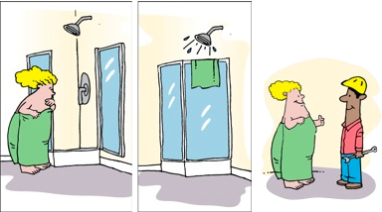
Types of Testing
Unit Testing
Acceptance Testing
System Integration Testing
User Acceptance Testing (UAT)
Notes:
Complete business process, fit for use, usability
Agile approach
Meets business needs
Raises business confidence
Traditional Approach
Finding bugs
Verify quality later

Slide 19
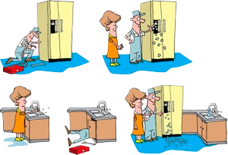
Types of Testing
Unit Testing
Acceptance Testing
System Integration Testing
User Acceptance Testing (UAT)
Regression Testing
Notes:
Regression = what was working isn’t working any more.
Agile approach
Continuous integration
Automated testing
Traditional Approach
Little automated testing
Expensive

Slide 20
Types of Testing
Unit Testing
Acceptance Testing
System Integration Testing
User Acceptance Testing (UAT)
Regression Testing
Exploratory Testing
Notes:
Simultaneous learning, test design, test execution.
Traditional – pre-defined test cases
Agile –starting early in the process
Exploratory Testing - is an approach to software testing that is concisely described as simultaneous learning, test design and test execution.
While the software is being tested, the tester learns things that together with experience and creativity generates new good tests to run.
Most valuable defects are found during exploratory testing.
Traditional – Since testing is always done at the end of the development cycle, mostly testers will have time to execute pre-defined test cases and get very little time to do exploratory testing.
Agile – Since testing happens in parallel to development, testers have enough time to do exploratory testing.

Slide 21
Unit Testing
Notes:
We’ll begin by looking at a little project in the Waterfall way, and see the results of doing it the “traditional” way.
And for those of you who have been through the first two modules, this one is a little bit different…

Slide 22
Unit Test
“A Unit Test is a procedure used to validate that individual units of functional code are working properly. “
Is usually done by developers
Improves quality
Facilitates changes
Simplifies integration
Enables automation
Provides effective system documentation
Makes your life simpler
Notes:
Read the definition.
Is usually done by developers
Improves quality
Facilitates changes
Simplifies integration
Enables automation
Provides effective system documentation.
Makes your life simpler
Assures that you have build the thing right (not necessarily the right thing)

Slide 23
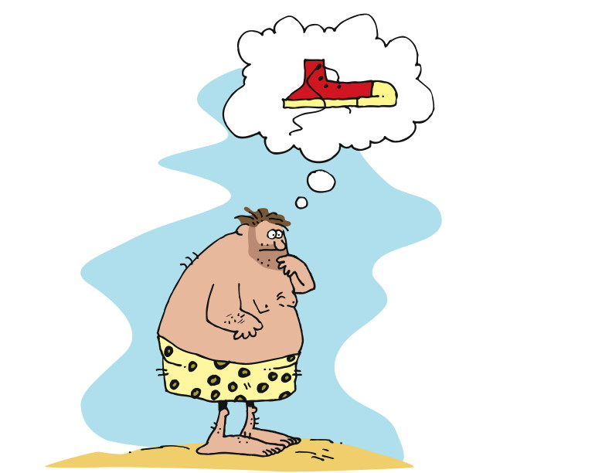
An Idea
“Test-driven development (TDD) is a software development technique that uses short development iterations based on pre-written test cases that define desired improvements or new functions. Each iteration produces code necessary to pass that iteration's tests. Finally, the programmer or team refactors the code to accommodate changes. A key TDD concept is that preparing tests before coding facilitates rapid feedback changes. Note that test-driven development is a software design method, not merely a method of testing.”
http://en.wikipedia.org/wiki/Test-driven_development
Notes:
Let’s start with a definition of Test-Driven Development:
“Test-driven development (TDD) is a software development technique that uses short development iterations based on pre-written test cases that define desired improvements or new functions. Each iteration produces code necessary to pass that iteration's tests. Finally, the programmer or team refactors the code to accommodate changes. A key TDD concept is that preparing tests before coding facilitates rapid feedback changes. Note that test-driven development is a software design method, not merely a method of testing.”
http://en.wikipedia.org/wiki/Test-driven_development
In simple terms, first figure out what you’re going to work on right now, then figure out how to determine if you’ve succeeded, then build it
[CLICK]
So here we have our hero. He has an idea. Shoes. After all, if you’ve been walking around barefoot all your life, stepping on stones and twigs, stubbing your toes, and otherwise suffering, shoes are a pretty darned good idea.

Slide 24
Unit Testing The Agile Way: Test First
Notes:
Now, let’s consider how we’d proceed in an Agile world, considering Test-Driven Development. The key aspect of Test-Driven Development is that the test is created BEFORE the development work is done, hence the name “test first” or “test-driven development”.

Slide 25
Test Driven Development
“Test-Driven Development (TDD) is an evolutionary approach to development which instructs you to have test-first development intent. Basically, you start by writing a test and then you code to elegantly fulfill the test requirements.”
Small successful, tested steps.
Do the simplest thing that could possibly work.
Notes:
Read the slide.
Small successful, tested steps.
Do the simplest thing that could possibly work.

Slide 26
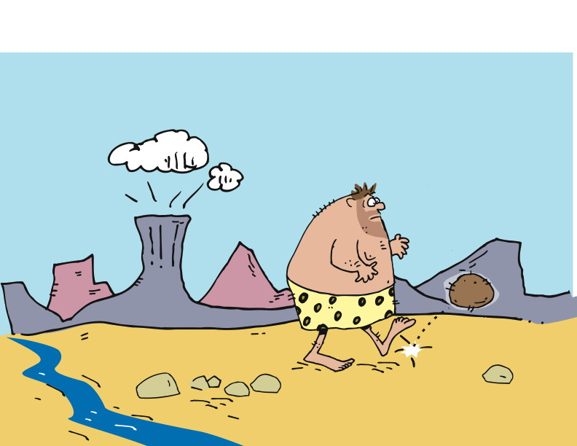
A User Story
Notes:
Hero is walking and stubs his toe.
Has an idea of somehow protecting his feet.
Comes up with a story - “As a walker, I want my feet protected from loose stones, so that I will have fewer bruises on my feet.”
---------------------------------------------------------------------------------------------------------------------
One day, our hero is walking along and stubs his toe on a rock. He identifies a need – he needs to stop stubbing his toes!
The need leads to an idea – the idea of covering his feet somehow, so he won’t stub his toes any more.
In our last module, we talked about user stories a bit. In this case, the story might be something like “As a walker, I want my feet protected from loose stones, so that I will have fewer bruises on my feet.”

Slide 27
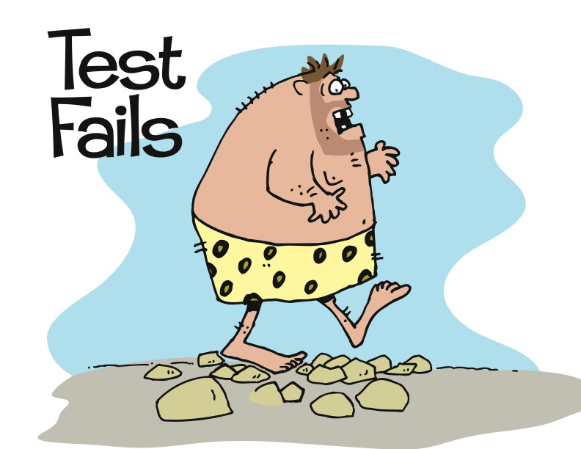
Test First
Notes:
1st the hero writes a test. When I walk on stones, my feet don’t hurt.”
He executes the test.
The test fails.
-----------------------------------------------------------------------------------------------
Unlike in our waterfall version, the first thing our hero does is to write the test.
His test says “When I walk on stones, my feet don’t hurt.”
Then he executes the test.
The results? OW! ☺
So here we have a very specific test that addresses a very specific need, and determines what will be developed.

Slide 28
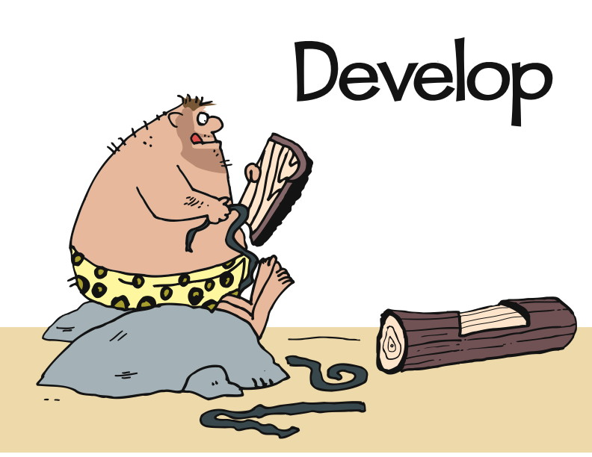
Notes:
Hero develops to get the test to pass.
Most simple design to get the test to pass. Walk on stones without hurting his feet.
Doesn’t address HOW. Just the result.
Develops to the result.
-----------------------------------------------------------------------------------------
During development, our hero has only one goal in mind – to get the test to pass.
That’s it. He wants to make that one, simpler, clear test pass.
So all he needs is something that will allow him to walk on stones without getting his feet hurt.
Notice that the test does not say HOW to pass. It just says what the results must be.
Off he goes, doing development with the intent of getting the test to pass.

Slide 29
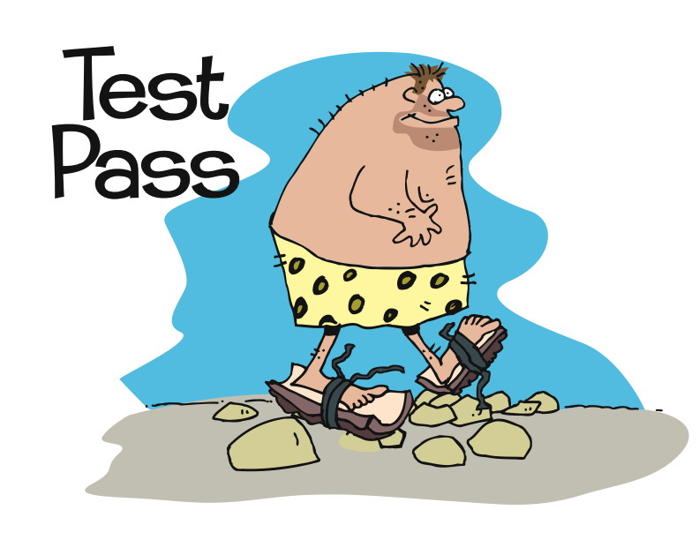
Notes:
Now the test passes.
And the test is part of the build process. Constantly rerunning the test every time a build is run.
----------------------------------------------------------------
And pass it does! Yes, it’s that simple. At least so far.
Determine what it is you are going to create by writing a test, then develop something that passes the test. It shouldn’t do anything more than it needs to to pass that test, however.
And that’s what our hero has here.
Of course, while the test has passed, he looks at what he’s done and realizes that it’s not ideal. It’s not even particularly good. It works, but what if…

Slide 30
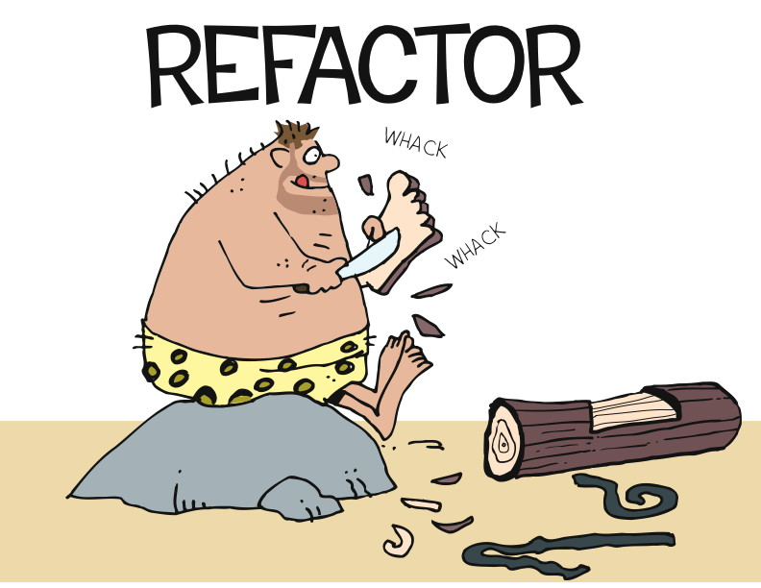
Notes:
We’re not going to go into detail about Refactoring quite yet, but it’s worth mentioning here because it’s part of test-driven development.
In this simple example, of course, our hero has only done one thing and passed one test. But after he’s done a few things, he may find that he’s created some cruft – some stuff that’s not elegant or simple or clear or maintainable. So he’ll sit down and do some modification in order to make it more elegant, simpler, clearer, or more maintainable.
If you recall, we talked in an earlier module about W. Edwards Deming and his PDCA, or Plan-Do-Check-Act, cycle. You’ll run into that, or something very like it, over and over again as you learn about Agile.
In this case, the Plan is writing the first test, the Do is writing the code to pass the test, the Check is reviewing what you’ve got for elegant / simple / clear / maintainable, and the Act is the Refactoring, where necessary.
And then?

Slide 31
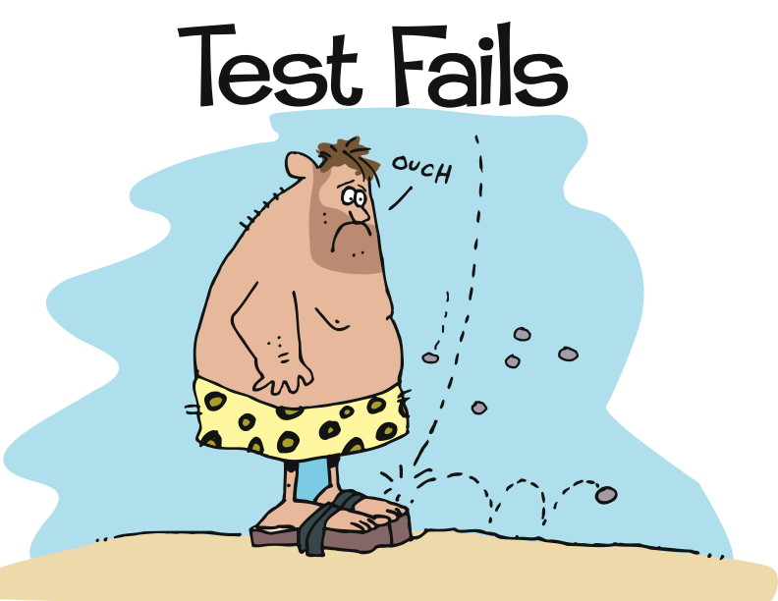
Notes:
A new requirement is received.
Protect my feet from falling objects.
New code is added to accommodate this requirement.
Again, write the test first.
Commit to unit testing by writing the test first
Restrict development to only that to pass the test. And any existing tests.
Know exactly when we are done.
--------------------------------------------------------------------------------------------------------------------------------------------
We do it again. We identify another requirement, which we represent with another test. This will lead us to doing more development, reviewing what we’ve got, and maybe doing some refactoring.
What’s important in all of this, however, is that we start with the test. There are several different points of value in this:
We commit to unit testing everything we do, because we write the test first.
We restrict ourselves to writing only the code we need to satisfy the test, and any existing tests. This keeps our code clean, because we’re not adding stuff that “we might need later.” We don’t consider later, we only consider the now.
Because we start with the test, we know when we’re done – the test has passed! There’s no question about it, since it’s simple and clear.
First, write the test. Then, write the code. When the test passes, you’re done.

Slide 32
Uncle Bob Martin’s Three Laws of TDD
You are not allowed to write any production code unless it is to make a failing unit test pass.
You are not allowed to write any more of a unit test than is sufficient to fail; and compilation failures are failures.
You are not allowed to write any more production code than is sufficient to pass the one failing unit test.
Notes:
What are the benefits of doing TDD?
All code is testable by definition!
In order to test any module in isolation you must decouple it, so TDD forces you to decouple modules.
This forces you to make better designs.
The Law of Diminishing Returns
This is why many actually consider TDD to be a DESIGN practice and not a Development Practice.
“When you follow the three rules of TDD, all your code will be testable by definition! And another word for "testable" is "decoupled". In order to test a module in isolation, you must decouple it. So TDD forces you to decouple modules. Indeed, if you follow the three rules, you will find yourself doing much more decoupling than you may be used to. This forces you to create better, less coupled, designs”
http://butunclebob.com/ArticleS.UncleBob.TheThreeRulesOfTdd

Slide 33
99 Test Balloons
Preparation
Self-organize into teams of 4 or 5
Objective
Copy the balloon that I have created.
The balloon has two round eyes, a triangular nose, and a semi circle mouth.
You have 2 minutes to create as many of the balloons as possible

Slide 34

What causes tester/developer animosity?
Notes:
Now that we have an idea of WHEN we address quality, let’s talk a bit about the various kinds of testing, and where and when they are used.

Slide 35
The crux of the problem…
What causes Tester/Developer animosity?
Physical separation/Lack of face-to-face communication
No shared responsibility towards quality
Misaligned metrics
Timing of testing
Schedule pressure
SOLUTION: Integrate all capabilities into single co-located team, using conversation (e.g., standups) and shared storywall to show status of testing
SOLUTION:
Heavy emphasis on developer testing of stories during development
SOLUTION: Entire team measured by how effectively stories can be moved through the entire process, not any capability-specific steps
SOLUTION:
Testing runs in parallel with development for the entire duration of development
Notes:
Physical separation means relationships between testers and developers cannot be built up effectively
Lack of face-to-face communication means communication is misinterpreted (especially bug reports) and exacerbated by physical separation
No shared responsibility towards quality means developers didn’t feel like testing was something they needed to do
Misguided metrics meant developers weren’t measured on producing high quality code and testers were measured on simply finding lots of defects
Timing of testing meant testers were brought into the project too late, meaning their knowledge of the requirements was scant and the testing itself was left too late
Schedule pressure is a problem when testing is the last large task before production deployment

Slide 36
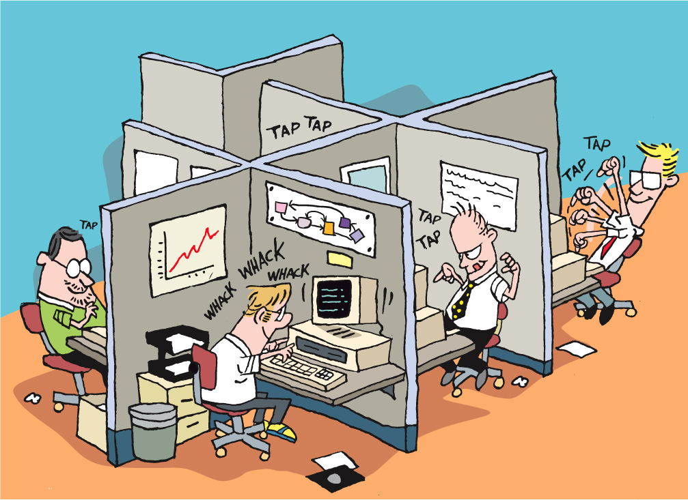
Physical separation / Lack of face-to-face communication
What can you do about it?
Integrate all capabilities into single collocated team, using conversation (e.g., standups) and shared storywall to show status of testing
Notes:
Physical separation means relationships between testers and developers cannot be built up effectively
Lack of face-to-face communication means communication is misinterpreted (especially bug reports) and exacerbated by physical separation

Slide 37
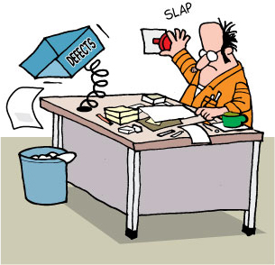
No shared responsibility towards quality
What can you do about it?
Heavy emphasis on developer testing of stories during development
Notes:
No shared responsibility towards quality means developers didn’t feel like testing was something they needed to do

Slide 38
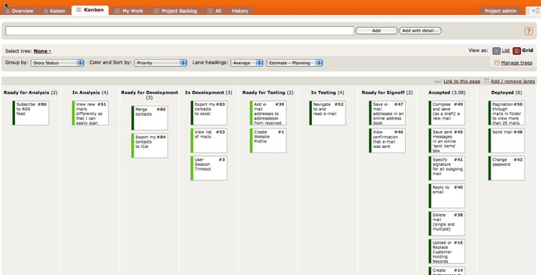
Misaligned metrics
What can you do about it?
Entire team measured by how effectively stories can be moved through the entire process, not any capability-specific steps
Notes:
Misguided metrics meant developers weren’t measured on producing high quality code and testers were measured on simply finding lots of defects
Now everyone is measured on how efficiently a card works through the process. Gets to done.

Slide 39
Timing of testing. Schedule pressure.
What can you do about it?
Testing runs in parallel with development for the entire duration of development
Notes:
Timing of testing meant testers were brought into the project too late, meaning their knowledge of the requirements was scant and the testing itself was left too late
Schedule pressure is a problem when testing is the last large task before production deployment

Slide 40
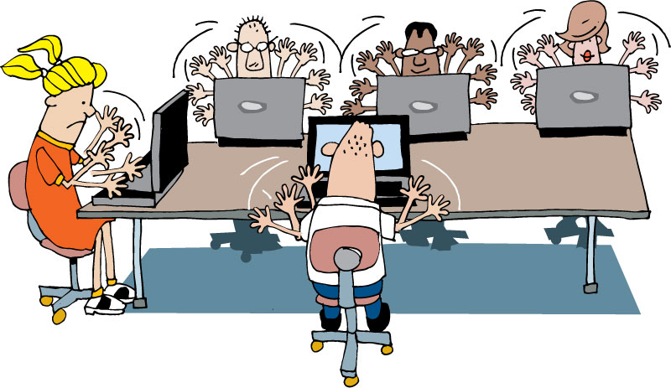
Tips for collaboration
NOT Us versus Them
NO excuses
Testing not just for testers!
Automation support
Environment set-up
Management support
End to end scenario creation
Notes:
Approach testing from a collaborative perspective
Shared commitment – all roles contribute to the quality of the solution
Testing moves from being a job title to a mindset of the team
It is not testers versus developers
Working together helps everybody on the team to improve their skills.
Use others strengths and let team members know yours to get the best result as a team.
No butt covering
Testing tasks do not always need to be done by testers:
Automation support from developers
Environment set-up and management support from sys admin
End to end scenario creation from BA etc.
-------------------------------------------------------------------------------------------------------------------------------------------------
Another key element to the Agile testing approach is to approach the practice from a collaborative perspective. With a shared commitment to quality, system administrators, analysts, developers and testers all collaborate in various ways to ensure the quality of the solution being developed. With this mindset, testing moves from being a job title to a skill which is scattered across the team based on the various strengths of the people involved.

Slide 41

Tips for collaboration
It is not testers versus developers
Working together helps everybody on the team to improve their skills.
No butt covering
Use others strengths and let team members know yours to get the best result as a team.
Testing tasks do not always need to be done by testers:
Automation support from developers
Environment setup and management support from sys admin
End to end scenario creation from BA etc.
Notes:
Approach testing from a collaborative perspective
Shared commitment – all roles contribute to the quality of the solution
Testing moves from being a job title to a mindset of the team
-------------------------------------------------------------------------------------------------------------------------------------------------
Another key element to the Agile testing approach is to approach the practice from a collaborative perspective. With a shared commitment to quality, system administrators, analysts, developers and testers all collaborate in various ways to ensure the quality of the solution being developed. With this mindset, testing moves from being a job title to a skill which is scattered across the team based on the various strengths of the people involved.
41

Slide 42
The Testers Bill of Rights
And what about the right to suggest and challenge requirements???
You have the right to:
Ask questions of customers and programmers and receive timely answers
Bring up issues related to quality and process at any time
Ask for and receive help from anyone on the project team, including programmers, managers, and customers
The tools you need to do your job in a timely manner
“Testing Extreme Programming” – Lisa Crispin
Notes:
Discussion time……
Are these rights representative of how you work as a tester today?
Do you get access to the customer(s) or their proxies to ask questions?
Can you ask the developers for help in testing parts of the application?
Do you feel you have good tool support in the testing you do, or are you aware of considerably more effective tools you could use if they were available to you?
[CLICK]
Do you have the ability to suggest or challenge requirements. Should you?

Slide 43
Acceptance Criteria
Notes:
How do the testers know what to test?
Where do they get their information?
The acceptance criteria drives the testing.

Slide 44

Writing acceptance criteria
Collaborative
How will you know?
Multiples per story
All or nothing
Notes:
Use the Wisdom of Crowds approach to defining.
Diverse set of independent individuals
Maximise the effectiveness of decision making process
BA, Biz, Devs, QA all participate in defining the acceptance criteria
----------------------------------------------------------------------------------------------------------------------------------------
If you have attended the Leadership or Project Management training, you will recall the concept of Collective Wisdom, or Wisdom of the Crowds. In short, collective wisdom demands the use of a large, diverse set of independent individuals to maximise the effectiveness of decision making processes. This same approach should be considered for acceptance criteria in order to obtain the best coverage of criteria across the requirement. Developers, analysts, architects and testers should all be able to provide useful input to generating acceptance criteria.
If you don’t have any background information on these topics, try http://en.wikipedia.org/wiki/Collective_wisdom or http://en.wikipedia.org/wiki/The_Wisdom_of_Crowds .
REMOVED
Derived with the customer and someone technical to provide feasibility
Ask the customer: What will you observe when the story is successfully complete?
Use Wisdom of Crowds
Most stories will generate multiple criteria
All must be met before the story can be completed
Consider using a template

Slide 45
Creating SMART acceptance criteria
Specific | Explicitly defined and definite
Measurable | Possible to observe and quantify
Achievable | Capable of existing/taking place
Relevant | Having a connection with the story
Timely | When will the outcome be observed?
Notes:
SMART acronym is widely applicable to many situations
Used to rate suitability
5 criteria are interconnected.
Measurable will naturally be Achievable and Specific.
Timely – drives home the independent concept of a story.
--------------------------------------------------------------------------------------------------------------
The SMART acronym is widely applicable to many situations and is also commonly used to rate meeting actions for suitability. The five criteria are somewhat interconnected in that Measurable criteria will probably also naturally be Achievable and Specific.
From a story point of view, the Timely criteria is worthy of separate discussion. It’s vital that the criteria for a story don’t assume the completion of another story in the same or later iterations. For obvious reasons you want to keep the criteria as independent as possible from other stories and not be linked to other stories that may or may not be delivered within the same timeframe.

Slide 46
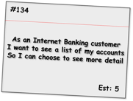
Acceptance criteria samples
Given the customer has one transaction account and one credit account
When they have completed logging in
Then the screen should show the names and numbers of the two accounts sorted in account number order
Given the customer has just one transaction account
When they have completed logging in
Then the screen should show the name and number of the account
Given the customer has no accounts
When they have completed logging in
Then the screen should show a message stating that no accounts are available
Alternate path
Given the customer has more than 20 accounts
When they have completed logging in
Then the screen should show the first 20 accounts (in account number order) only
Alternate path
Given the customer has some accounts
When they have completed logging in
And the system cannot retrieve the account details
Then the screen should show an error message with associated code and details to contact for support
Bad path
Notes:
This format is iteration level acceptance criteria vs. Inception level.
Shows positive, alternate and bad paths.
Talk through each one.
-----------------------------------------------------------------------
Here we see a set of criteria for an Internet Banking story covering a range of positive, alternate and bad paths through the requirement. As is expected, the positive paths map directly to the requirements as stated and assume everything is working as expected.
The alternate path criteria describe non-standard ways to meet the desired outcome, which although may not be considered within the narrative of the story, are still reasonable to assume as usage patterns for the system.
Bad path criteria describe situations in which the outcome cannot be achieved, in this case how the system would behave in the case of an internal error.

Slide 47
Agile Automation
Notes:
Transparency is extended to how to report on Quality.

Slide 48
Why automation is important?
For faster feedback
Gives confidence to the development team
Testing a rapidly changing application manually is next to impossible
Notes:
Once you see a green bar for your functional test suite, developer is confident about his checkin
Faster feedback is one of the pillars of agile - automation helps to achieve the same.

Slide 49
Automation in an Agile team
What is different?
Automation happens parallel to development
Automate acceptance tests, more than end-to-end tests (in general)
Automated tests form a regression test suite and is executed in CI to give faster feedback

Slide 50
Why automation fails in Agile teams
Over-engineering your test scripts/framework
Trying to test everything through functional tests
Wrong choice of tools
Notes:
Can also talk about agile friendly tools
http://agilesoftwaretesting.com/?p=56

Slide 51
What is wrong with traditional tools?
Test-last workflow encouraged by such tools does not fit Agile team
Scripts created by those tools becomes un-maintainable
Needs test automation specialist
Such tools does not encourage collaboration
Ref - http://testobsessed.com/2008/04/29/agile-friendly-test-automation-toolsframeworks/
Notes:
Why Traditional, Record-and-Playback, Heavyweight, Commercial Test Automation Solutions Are Not Agile
Three key reasons:
The test-last workflow encouraged by such tools is all wrong for Agile teams.
The unmaintainable scripts created with such tools become an impediment to change.
Such specialized tools create a need for Test Automation Specialists and thus foster silos.
Let’s look at each of these concerns in turn, then look at how Agile-friendly tools address them.
Test-Last Automation
Traditional, heavyweight, record-and-playback tools force teams to wait until after the software is done – or at least the interface is done – before automation can begin. After all, it’s hard to record scripts against an interface that doesn’t exist yet. So the usual workflow for automating tests with a traditional test automation tool looks something like this:
Test analysts design and document the tests
Test executors execute the tests and report the bugs
Developers fix the bugs
Test executors re-execute the tests and verify the fixes (repeating as needed)
…time passes…
Test automation specialists automate the regression tests using the test documents as specifications
Looking at the workflow this way, it’s surprising to me that this particular test automation strategy ever works, even in traditional environments with long release cycles and strict change management practices. By the time we get around to automating the tests, the software is done and ready to ship. So those tests are not going to uncover much information that we don’t already know.
Sure, automated regression tests are theoretically handy for the next release. But usually the changes made for the next release break those automated tests (see concern #2, maintainability, coming up next). The result for most contexts: high cost, limited benefit. In short, such a workflow is a recipe for failure on any project, not just for Agile teams. The teams that have made this workflow work well in their context have had to work very, very hard at it.
However, this workflow is particularly bad in an Agile context where it results in an intolerably high level of waste and too much feedback latency.
Waste: the same information is duplicated in both the manual and automated regression tests. Actually, it’s duplicated elsewhere too. But for now, let’s just focus on the duplication in the manual and automated tests.
Feedback Latency: the bulk of the testing in this workflow is manual, and that means it takes days or weeks to discover the effect of a given change. If we’re working in 4 week sprints, waiting 3 – 4 weeks for regression test results just does not work.
Agile teams need the fast feedback that automated system/acceptance tests can provide. Further, test-last tools cannot support Acceptance Test Driven Development (ATDD). Agile teams need tools that support starting the test automation effort immediately, using a test-first approach.
Unmaintainable Piles of Spaghetti Scripts
Automated scripts created with record-and-playback tools usually contain a messy combination of at least three different kinds of information:
Expectations about the behavior of the software under test given a set of conditions.
Implementation-specific details about the interface.
Code to drive the application to the desired state for testing.
So a typical script will have statements to click buttons identified by hard-coded button ids followed by statements that verify the resulting window title followed by statements to verify the calculated value in a field identified by another hard-coded id, like so:
field("item_1").enter_value("12345") button("lookup_item_1").click field("price_1").verify_value("$7.00") field("qty_1").enter_value("6") button("total_next").click active_window.verify_title("Checkout") field("purchase_total").verify_value("$42.00")
The essence of the test was to verify that ordering 6 items at $7 each results in a shopping cart total of $42. But because the script has a mixture of expectations and UI-specific details, we end up with a whole bunch of extraneous implementation details obfuscating the real test.
(If you’re nodding along, thinking to yourself, “Yup, looks like our test scripts,” then you have my sympathies. My deep, deep sympathies. Good, maintainable, automated test scripts do not look like that.)
All that extraneous stuff doesn’t just obscure the essence of the test. It also makes such scripts hard to maintain. Every time a button id changes, or the workflow changes, say with a “Shipping Options” screen inserted before the Checkout screen, the script has to be updated. But that value $42.00? That only changes if the underlying business rules change, say during the “Buy 5, get a 6th free!” sale week.
Of course, there are teams that have poured resources, time, and effort into creating maintainable tests using traditional test automation tools. They use data-driven test strategies to pull the test data into files or databases. They create reusable libraries of functions for common action sequences like logging in. They create an abstract layer (a GUI map) between the GUI elements and the tests. They use good programming practices, have coding standards in place, and know about refactoring techniques to keep code DRY. I know about these approaches. I’ve done them all.
But I had to fight the tools the whole way. The traditional heavyweight test automation tools are optimized for record-and-playback, not for writing maintainable test code. One of the early commercial tools I used even made it impossible to create a separate reusable library of functions: you had to put any general-use functions into a library file that shipped with the tool (making tool upgrades a nightmare). That’s just EVIL.
Agile teams need tools that separate the essence of the test from the implementation details. Such a separation is a hallmark of good design and increases maintainability. Agile teams also need tools that support and encourage good programming practices for the code portion of the test automation. And that means they need to write the test automation code using real, general use languages, with real IDEs, not vendor script languages in hamstrung IDEs.
Silos of Test Automation Specialists
Traditional QA departments working in a traditional waterfall/phased context, and automating tests, usually have a dedicated team of test automation specialists. This traditional structure addresses several forces:
Many “black-box” testers don’t code, don’t want to code, and don’t have the necessary technical skills to do effective test automation. Yes, they can click the “Record” button in the tool. But most teams I talk to these days have figured out that having non-technical testers record their actions is not a viable test automation strategy.
The license fees for traditional record-and-playback test automation tools are insanely expensive. Most organizations simply do not have the budget to buy licenses for everyone. Thus only the anointed few are allowed to use the tools.
Many developers view the specialized QA tools with disdain. They want to write code in real programming languages, not in some wacky vendorscript language using a hamstrung IDE.
Thus, the role of the Test Automation Specialist was born. These specialists usually work in relative isolation. They don’t do day-to-day testing, and they don’t have their hands in the production code. They have limited interactions with the testers and developers. Their job is to turn manual tests into automated tests.
That isolation means that if the production code isn’t testable, these specialists have to find a workaround because testability enhancements are usually low on the priority list for the developers. I’ve been one of these specialists, and I’ve fought untestable code to get automated tests in place. It’s frustrating, but oddly addictive. When I managed to automate tests against an untestable interface, I felt like I’d slain Grendel, Grendel’s mother, all the Grendel cousins, and the horse they rode in on. I felt like a superhero.
But Agile teams increase their effectiveness and efficiency by breaking down silos, not by creating test automation superheroes. That means the test automation effort becomes a collaboration. Business stakeholders, analysts, and black box testers contribute tests expressed in an automatable form (e.g. a Fit table) while the programmers write the code to hook the tests up to the implementation.
Since the programmers write the code to hook the tests to the implementation while implementing the user stories, they naturally end up writing more testable code. They’re not going to spend 3 days trying to find a workaround to address a field that doesn’t have a unique ID when they could spend 5 minutes adding the unique ID. Collaborating means that automating tests becomes a routine part of implementing code instead of an exercise in slaying Grendels. Less fun for test automation superheroes, but much more sensible for teams that actually want to get stuff done.
So that means Agile teams need tools that foster collaboration rather than tools that encourage a whole separate silo of specialists.

Slide 52
Agile friendly tools
Characteristics of agile friendly tool:
Support starting test automation effort immediately
Separate the test intent from the implementation details
Support and encourage good programming practices for the code portion
Support writing test automation code using real languages, with real IDEs
Foster collaboration
Ref - http://testobsessed.com/2008/04/29/agile-friendly-test-automation-toolsframeworks/
Notes:
Characteristics of Effective Agile Test Automation Tools
Reviewing the problems with traditional test automation tools, we find that Agile teams need test automation tools/frameworks that:
Support starting the test automation effort immediately, using a test-first approach.
Separate the essence of the test from the implementation details.
Support and encourage good programming practices for the code portion of the test automation.
Support writing test automation code using real languages, with real IDEs.
Foster collaboration.
Fit, Fitnesse, and related tools (see the list at the end of the post for more) do just that.
Testers or business stakeholders express expectations about the business-facing, externally visible behavior in a table using keywords or a Domain Specific Language (DSL). Programmers encapsulate all the implementation details, the button-pushing or API-calling bits, in a library or fixture.
So our Shopping Cart example from above might be expressed like this:
Choose item by sku 12345 Item price should be $7.00 Set quantity to 6 Shopping cart total should be $42.00
See, no button IDs. No field IDs. Nothing except the essence of the test.
And by writing our test in that kind of stripped-down-to-the-essence way makes it no longer just a test. As Brian Marick would point out, it’s an example of how the software should behave in a particular situation. It’s something we can articulate, discuss, and explore while we’re still figuring out the requirements. The team as a whole can collaborate on creating many such examples as part of the effort to gain a shared understanding of the real requirements for a given user story.
Expressing tests this way makes them automatable, not automated. Automating the test happens later, when the user story is implemented. That’s when the programmers write the code to hook the test up to the implementation, and that’s when the test becomes an executable specification.
Before it is automated, that same artifact can serve as a manual test script. However, unlike the traditional test automation workflow where manual tests are translated into automated tests, here there is no wasteful translation of one artifact into another. Instead, the one artifact is leveraged for multiple purposes.
For that matter, because we’re omitting implementation-specific details from the test, the test can be re-used if the system were ported to a completely different technology. There is nothing specific to a Windows or Web-based interface in the test. The test would be equally valid for a green screen, a Web services interface, a command line interface, or even a punch-card interface. Leverage. It’s all about the leverage.

Slide 53
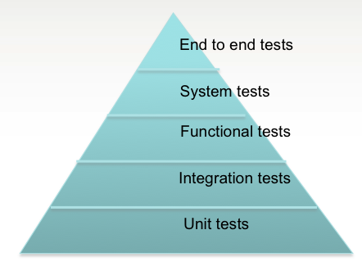
How much to automate?
Answer: It depends!
But, what we suggest is -

Slide 54
Quality Metrics
Notes:
Transparency is extended to how to report on Quality.

Slide 55
Metrics and reporting: goals
Answer these questions
How busy is Testing?
What is the quality of the software?
What is the level of risk in the software?
What is our progress?
How good is our testing?
Notes:
Reporting metrics that answer these questions
Pairing metrics with answering these questions gives more context
----------------------------------------------------------------------------------------------------------------
So hopefully we’re all of the opinion that without context metrics can paint misleading or even downright incorrect pictures of the state of the software being tested. An alternative approach is to pair whatever metrics are being used with answers to these five questions. Each one reports on a different aspect of the testing process and give the ability to provide the context that is so often missing from pure metric-based reporting.
Obviously these questions will produce subjective opinions in the answers, but even this subjectivity along with frequent reporting and established trust should give a accurate representation of the testing efforts.

Slide 56
Metrics and reporting: goals
Answer these questions
How busy is Testing?
What is the quality of the software?
What is the level of risk in the software?
What is our progress?
How good is our testing?
Notes:
How busy is testing?
This allows the IM to understand if testers need help or if testers can help somewhere else
Burn up. Shows the total test to be completed and what remains.
Stories w/out test cases may mean that the testers are behind in writing test cases or something else.
----------------------------------------------------------------------------------------------------------------
So hopefully we’re all of the opinion that without context metrics can paint misleading or even downright incorrect pictures of the state of the software being tested. An alternative approach is to pair whatever metrics are being used with answers to these five questions. Each one reports on a different aspect of the testing process and give the ability to provide the context that is so often missing from pure metric-based reporting.
Obviously these questions will produce subjective opinions in the answers, but even this subjectivity along with frequent reporting and established trust should give a accurate representation of the testing efforts.

Slide 57
Metrics and reporting: goals
Answer these questions
How busy is Testing?
What is the quality of the software?
What is the level of risk in the software?
What is our progress?
How good is our testing?
Notes:
Severity of defects found.
How bad from a technical perspective.
Defect finder rating.
Failed tests by functional area
Priority of defects found.
What order defects should be fixed
Biz, customer, product manager rating.
----------------------------------------------------------------------------------------------------------------
So hopefully we’re all of the opinion that without context metrics can paint misleading or even downright incorrect pictures of the state of the software being tested. An alternative approach is to pair whatever metrics are being used with answers to these five questions. Each one reports on a different aspect of the testing process and give the ability to provide the context that is so often missing from pure metric-based reporting.
Obviously these questions will produce subjective opinions in the answers, but even this subjectivity along with frequent reporting and established trust should give a accurate representation of the testing efforts.

Slide 58
Metrics and reporting: goals
Answer these questions
How busy is Testing?
What is the quality of the software?
What is the level of risk in the software?
What is our progress?
How good is our testing?
Notes:
Stories bouncing back to development means that something is not right with the acceptance criteria or the dev work.
Stories without test cases is obvious risk that functionality is not being tested.
----------------------------------------------------------------------------------------------------------------
So hopefully we’re all of the opinion that without context metrics can paint misleading or even downright incorrect pictures of the state of the software being tested. An alternative approach is to pair whatever metrics are being used with answers to these five questions. Each one reports on a different aspect of the testing process and give the ability to provide the context that is so often missing from pure metric-based reporting.
Obviously these questions will produce subjective opinions in the answers, but even this subjectivity along with frequent reporting and established trust should give a accurate representation of the testing efforts.

Slide 59
Metrics and reporting: goals
Answer these questions
How busy is Testing?
What is the quality of the software?
What is the level of risk in the software?
What is our progress?
How good is our testing?
Notes:
Kind of a burn up for the total project.
By functional area, how many points are in testing now.
----------------------------------------------------------------------------------------------------------------
So hopefully we’re all of the opinion that without context metrics can paint misleading or even downright incorrect pictures of the state of the software being tested. An alternative approach is to pair whatever metrics are being used with answers to these five questions. Each one reports on a different aspect of the testing process and give the ability to provide the context that is so often missing from pure metric-based reporting.
Obviously these questions will produce subjective opinions in the answers, but even this subjectivity along with frequent reporting and established trust should give a accurate representation of the testing efforts.

Slide 60
Metrics and reporting: goals
Answer these questions
How busy is Testing?
What is the quality of the software?
What is the level of risk in the software?
What is our progress?
How good is our testing?
Notes:
Very subjective
----------------------------------------------------------------------------------------------------------------
So hopefully we’re all of the opinion that without context metrics can paint misleading or even downright incorrect pictures of the state of the software being tested. An alternative approach is to pair whatever metrics are being used with answers to these five questions. Each one reports on a different aspect of the testing process and give the ability to provide the context that is so often missing from pure metric-based reporting.
Obviously these questions will produce subjective opinions in the answers, but even this subjectivity along with frequent reporting and established trust should give a accurate representation of the testing efforts.

Slide 61
Defects

Slide 62

Defects
“A defect is behavior in a ‘Done’ story that violates valid expectations of the [Customer]”
Elisabeth Hendrickson
Not all defects need to be logged.
Only capture defects if they wont be fixed right away.
You want developers to feel comfortable showing you something that is not complete to get some guidance.
Notes:
Elisabeth Hendrickson
Runs a company called Quality Tree Software
Started in 1997
In 2003 became active in the agile community
How well would your organisation react to the “not all defects need to be logged” suggestion? Is this way of working in line with the cultural values of your employer.
How would your manager react?
Are you currently being measured, either explicitly or implicitly, on the number of defects you find?
Finally, what would the developers think?

Slide 63
When to raise a defect
Ready
In Dev
Ready for Test
In Test
Done
A
B
D
E
G
H
Found a problem here?
Push story back but do not create defect
or
For minor issues create defect
and let story pass (if business agree)
F
Found a problem here?
Raise and track the defect
C
Notes:
Minimize the cost of managing defects
Zero tolerance approach to defects – fix then (during BA review).
Customer may make the defect a lower priority, but tech should consider severity when agreeing to let the defect go.
[CLICK]
Report a defect when its found after the story was considered ‘done’.
[CLICK]
Question about associating defects with stories.
Only if needed. Yes, when possible. Gives people context.
-----------------------------------------------------------------------------------------------------------------------------------------
For many Agile teams, the point at which a defect needs to be created and managed as such is when it has been found after initial testing and the story is considered to be “Done”. Ideally, this also coincides with the end of the iteration. The main thinking behind this approach is to take a (close to) zero tolerance approach to defects (i.e., fix then as found, before the story is completed) and to minimise the cost of managing an official defect.
At the customers’ discretion, defects may be allowed out of the iteration but the team should push back on this if the existence of these defects is causing other problems (i.e., consequential defects or confusion).

Slide 64
Defect management
Appears on story-wall as separate card
Prioritized by business over new functionality
Categorized as per usual
Should defects be estimated?
When raising a defect should you associate it with a story?
Notes:
Read through the bullets.
[CLICK]
Defects are typically not estimated. Options: a developer or set of devs are assigned to defects during an iteration.
[CLICK]
Yes, defects should be associated with a story when possible. It gives context.
A defect can be considered to just be a requirement that has yet to be implemented… and we already have an established Agile process for working with such requirements; stories and the story wall.

Slide 65
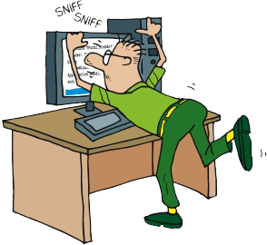
Common testing issues/smells
Is it really a defect?
Bouncing defects
Automation failures
Accepting stories, then raising defects
Repeating business logic in tests
Notes:
Experienced testers will have witnessed many or all of these smells (issues) at some point in their career, but this is by no means a definitive list of all the common testing problems that could happen. Indeed, many of these smells are symptomatic of issues deeper in the team that are manifesting itself in the testing space.
Effective Agile testing will often raise issues that have been previously hidden within dysfunctional teams or poorly managed projects.
Long debates over whether a defect is a real defect or just a valid interpretation of the requirements
Stories continually bouncing back and forth between Dev Complete and In Testing columns on the storywall
Continuous failing of (long running) automation suite, leading to increase in regression defects
Accepting stories and raising defects
Repeating same business logic in the tests. Possible indicator that tests have not been refactored, team not doing TDD and/or that business logic is being tested in the wrong place (or multiple places). E.g., integration test that validates whether calculation works, and a GUI test does the same thing.
Only a single test case created for each acceptance criterion

Slide 66
Pairing
Notes:
Let’s start with something fun: Common arguments against pair programming….

Slide 67
Pairing
Why it sucks, and why you should hate it

Slide 68
It’s distracting!
Hard to focus on the problem at hand when your pair is sitting next to you talking

Slide 69
Costly
Two people doing the work of one

Slide 70
Low morale
Only spend 50% of your time doing any actual work

Slide 71
Hygiene
What?! I have to shower every day?!

Slide 72
Stop slowing me down!
Explaining thoughts to my pair will slow me down

Slide 73
Pair Programming
Now let’s talk about the reasons you should do it

Slide 74
Development The Waterfall Way
Notes:
Now that we’ve talked about Test-Driven Development, it’s time to talk about Development. That is, the work you do to pass tests and deliver value.
First, of course, we’ll look at the Waterfall way.

Slide 75
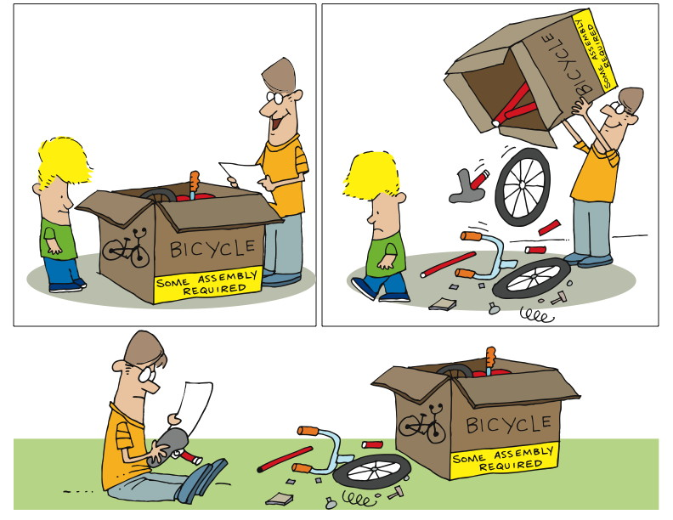
Pairing 1
Notes:
We sit down, confident of our ability.
We read the instructions, follow them carefully.
At some point we realize we’ve put widget A into slot 1 as we were told, but we put it in BACKWARDS.
Take it apart to reverse widget A
Let’s consider the classic approach. For those of you who are parents, or who have ever bought anything that says that dreaded phrase “some assembly required” – this example is for you!
Most of us have had the same kinds of experiences. We sit down, confident of our ability to put the thing together. We read the instructions, and we follow them very, very carefully. And, at some point, we realize that we’ve put widget A into slot B, just as we were supposed to, but we put it in BACKWARDS! And now we have to take the thing apart far enough to reverse widget A. And then we get to put it all together again. Sigh.

Slide 76
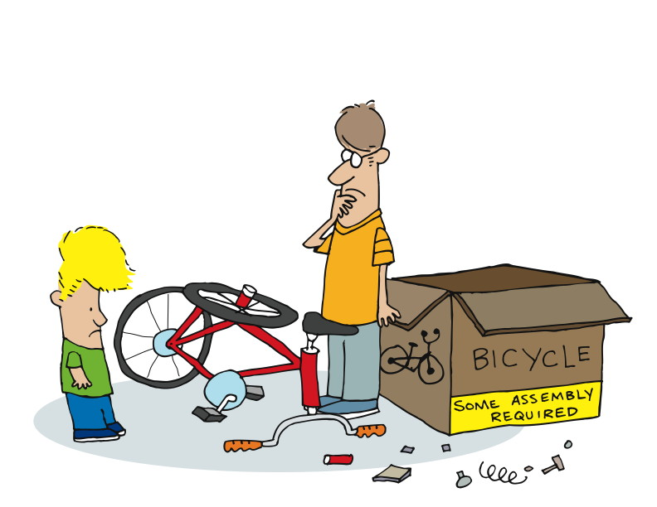
Pairing 2
Notes:
Or we get to the end, but it just doesn’t look right.
How can we avoid this?
-----------------------------------------------------------------------------------------------------------------
Or we get all the way to the end, only to find that we’ve somehow managed to put it all together, but it doesn’t look anything like the picture.
Why does this happen? How can we avoid it?
Maybe…

Slide 77
The Agile Way: Pairing
Notes:
In the module The Origins of Agile Software Development, we talked about Kent Beck and how he came up with Extreme Programming. At that time, we mentioned pairing. Let’s look at pairing in a little more detail now.
Here’s a definition:
“Pair programming is a software development technique in which two programmers work together at one work station. One types in code while the other reviews each line of code as it's typed in. The person typing is called the driver. The person reviewing the code is called the observer or navigator. The two programmers switch roles periodically.
“While reviewing, the observer also considers the strategic direction of the work, coming up with ideas for improvements and likely future problems to address. This frees the driver to focus all of his or her attention on the "tactical" aspects of completing the current task, using the observer as a safety net and guide.”
http://en.wikipedia.org/wiki/Pair_programming
Two of everything is better than one – minds, (pairs of) hands, (pairs of) eyes.
Let’s see why…

Slide 78
“Pair programming is a software development technique in which two programmers work together at one work station. One types in code while the other reviews each line of code as it's typed in. The person typing is called the driver. The person reviewing the code is called the observer or navigator. The two programmers switch roles periodically.
“While reviewing, the observer also considers the strategic direction of the work, coming up with ideas for improvements and likely future problems to address. This frees the driver to focus all of his or her attention on the "tactical" aspects of completing the current task, using the observer as a safety net and guide.”
http://en.wikipedia.org/wiki/Pair_programming

Slide 79
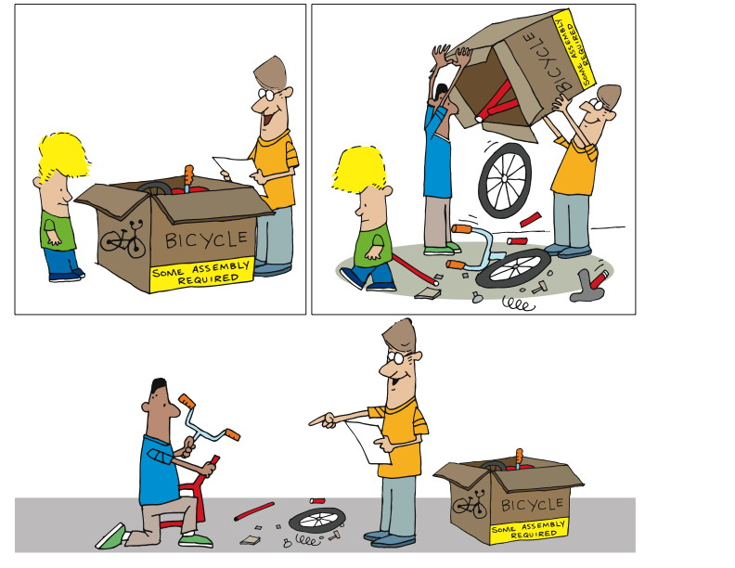
Pairing 3
Notes:
We believe that having 2 people working together produces better results.
Better means…
Fewer defects
Less rework
More creativity
Easier to maintain
Sitting side by side
Working on one piece of code
One is the driver – hands on the keyboard and mouse
Two is navigating, doing code review, asking questions, maybe doing research
Change roles periodically
Instead of being distracting, it turns out to be helpful, useful
-----------------------------------------------------------------------------------------------
Unlike in our classical approach, in Agile we believe that having two people working together produces better results. That is, by “better” we mean that there will be fewer defects, less rework, more creativity, and the results will be easier to maintain.
So in actual practice, pairing would say that there are two people sitting side by side, working on one piece of code together. One – as it said in the definition – is the driver, with hands on keyboard and mouse. The other will be navigating – doing real-time code review, asking questions, maybe doing a little research on the side. They will be bouncing ideas off each other. They will change roles periodically.

Slide 80
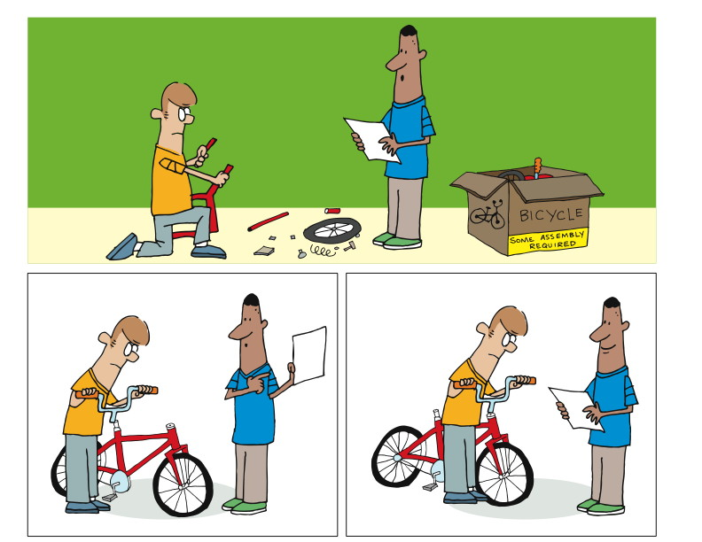
Pairing 4
Notes:
By switching roles,
they stay fresh,
check each other’s work and
get done faster
Instead of low morale, you get collaboration, quality and camaraderie
Let’s talk about quality
2 heads are better than 1 – solution is likely to be better
Will see the problem AS IT HAPPENS. If they are paying attention.
--------------------------------------------------------------------------------------------------------------------------
The driver becomes the navigator and the navigator becomes the driver. Between the two of them, they manage to stay reasonably fresh, to check each other’s work, and to get done faster.
Yes, faster.
But let’s get back to fewer defects. We’re all familiar with the adage “two heads are better than one.” This means that having two people thinking about the same problem is likely to produce a better solution than one working alone.
After all, if one of us is looking at the directions, and the other is putting the thing together, the odds are in our favor that the one looking at the directions and the pictures will notice that widget A is in slot B the wrong way AS IT HAPPENS.

Slide 81
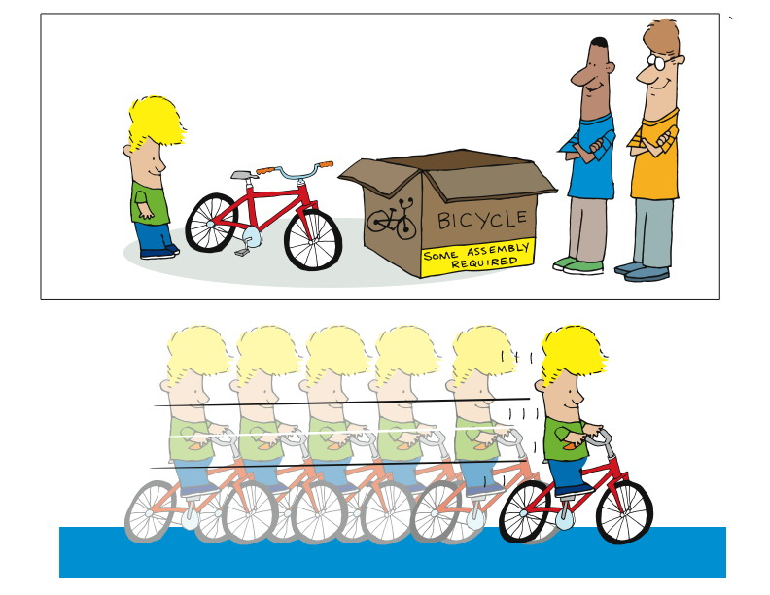
Pairing 5
Notes:
Now let’s get back to faster.
2 people doing the work of one?
Cost me 2x as much?
No to both.
Let’s take a bigger, longer view of the challenge.
-----------------------------------------------------------------------------------------------------------------------
We hear repeatedly “but doesn’t that mean that I have two people doing the work of one? Doesn’t’ that mean that it will cost me twice as much, or take twice as long, to get the same thing done?”
There are two answers to that, and both of them are “no”.
In order to understand the answer, you have to take a bigger and longer view of the challenge.

Slide 82
Notes:
It drives around the point when you find the defect.
If found after, I have to:
Undo what I’ve done
Redo it
Double checking other widgets
You could say that the one defect took 3 x the time and money
Now for the longer view.
If I leave widget A backwards, then
Slowly over time there is wear on widget A
It has to be replaced
Now I have to find the problem
Undo what I’ve done
Redo it
Double checking other widgets
Let’s get back to putting widget A the wrong way in slot B. In that case, I have to undo all the work I’ve done from the time I put widget A into slot B, right? Then I have to redo all the work I’ve done since then, double-checking my work to make sure I’m not putting any other widgets in backwards. That means that one single, solitary defect caused me to spend THREE TIMES the time and money to get the same job done. What if I’d caught that defect earlier? Then my cost might be 10% over, not 200% over.
Okay – that’s a relatively easy one. Now we’ll take the longer view…
Imagine that I get it all put together, and it works like a charm. Even though widget A is in slot B backwards, the thing works. But what’s happening is that widget A is slowly wearing, to the point that instead of having a life of five years, it has a life of five months! Assuming that everything else is working fine, all I have to do is disassemble the thing, get a new widget A, put it into slot B properly (assuming I figured out why it failed in the first place), and then rebuild the thing.
Yes, I just spent more like 500% of the original time, as compared to 300% if I catch it before I’m done in the first place, or 110% if I catch it as early as possible. Why 500%? Well, it might be 400%, and it might be 5,000%. The thing is, studies show that the cost of changing something when software is in production is DRAMATICALLY higher than changing it just after it’s done.
So if the minimal cost to fix one defect late in the game is 300%, and the cost of catching it and fixing it early is 110% or less, then if I catch just one bug in one piece of code at the time my pair is putting it in, I’ve just saved at least 80% in cost.
Let’s go over that…

Slide 83
110% * 2 = 220%
300%
300% - 220% = 80%
8 hours * .8 = 6.4 hours
6.4 * US$40 = US$256
US$256 * 1000 = US$256,000
Notes:
Catch a bug when working on it costs me 110% of the cost of development x 2 developers
Compared to 300% cost to fix when work is done or later.
Let’s say it took 8 hours to originally build the code.
$256 to fix the one bug.
What if there are 1000 bugs. Not unreasonable for a fairly large sized application.
Consider time 64,000 hours. About 160 person days.
------------------------------------------------------------------------------------------------------------------------
If it costs me 110% for two people, that’s 220%, right? So having two people working together, where they catch and fix one bug, costs 220%. Of course, they’ll catch and fix far more than one. But we’ll stick with just one for the moment.
Compare to that the cost to fix the bug after all the work is done. That’s 300% or higher, because we have to do all the work to figure out where the bug is, refresh our minds about the code, go fix the code, write a new test or two, verify that we haven’t broken anything, check to make sure whether anything else is affected by this change,…
Well, as you can see, the costs mount up very quickly.
For the sake of argument, we’ll say that it took eight hours to develop the code. Then the delta is 6.4 hours (eight hours times 80%).
Again, for the sake of argument, let’s say our developer gets paid forty dollars per hour. That’s a difference of $256. That means that without pairing, it could cost us $256 to fix this one bug if it’s caught late, rather than early.
$256 is not such a big deal, right? What if we expect to find and fix a measly one thousand bugs during the course of our development.
That’s two hundred fifty-six thousand dollars! That’s not small. And one thousand bugs is a small number for a sizable project.
And let’s not forget the time. That $256,000 also represents 6,400 person hours of effort! If we maintain the same size staff, that’s 160 person days added to our schedule, which is NOT included in our project plan.
As we consider this, also consider that 300% is pretty minimal, when you consider that the bug was probably found by QA or by a customer, so there’ll be time to reproduce it, document it, and report and track it. And of course once it’s supposedly fixed, there’s the cost of retesting and reverifying.
You can see that in the Agile community, there’s a strong argument in favor of pairing from many perspectives.

Slide 84
Studies
Cockburn, Alistair; Williams, Laurie (2000). "The Costs and Benefits of Pair Programming"
Lui, Kim Man; Keith C. C. Chan (September 2006). "Pair programming productivity: Novice-novice vs. expert-expert"
Arisholm, Erik; Hans Gallis, Tore Dybå, Dag I.K. Sjøberg (February 2007). "Evaluating Pair Programming with Respect to System Complexity and Programmer Expertise
Lui, Kim Man; Keith C. C. Chan, John Teofil Nosek (March/April 2008). "The Effect of Pairs in Program Design Tasks"
Hannay, Jo E.; Tore Dybå, Erik Arisholm, Dag I.K. Sjøberg (July 2009). "The Effectiveness of Pair Programming: A Meta-Analysis"
Notes:
These studies show a couple of key things:
Pair programmers are only 15% slower than two independent
Improved correctedness
Novice to experience
Complexity of task.
Public demo - http://blogs.agilefaqs.com/2010/06/13/pair-programming-public-demo/
Blog by Fred George - http://processpeoplepods.blogspot.com/search/label/Pair%20Programming
Based on a survey
100% agreed that they had more confidence in their solution than when they program alone
96% agreed that they enjoy their job more than when programming alone
Laurie Williams of the University of Utah in Salt Lake City has shown that paired programmers are only 15% slower than two independent individual programmers, but produce 15% fewer bugs
The Williams et al. 2000 study showed an improvement in correctness of around 15% and 20 to 40% decrease in time, but between a 15 and 60% increase in effort.
Williams et al. 2000 also cites an earlier study (Nosek 1998) which also had a 40% decrease in time for a 60% increase in effort.
A study (Lui 2006) presents a rigorous scientific experiment in which novice–novice pairs against novice solos experience significantly greater productivity gains than expert–expert pairs against expert solos.[
A larger recent study (Arisholm et al. 2007) had 48% increase in correctness for complex systems, but no significant difference in time, whilst simple systems had 20% decrease in time, but no significant difference in correctness. Overall there was no general reduction in time or increase in correctness, but an overall 84% increase in effort.^{[8][16]}
Lui, Chan, and Nosek (2008) shows that pair programming outperforms for design tasks.^{[17]}
A full-scale meta-analysis of pair programming experimental studies, from before or during 2007, (Hannay et al. 2009) confirms "that you cannot expect faster and better and cheaper". Higher quality for complex tasks costs higher effort, reduced duration for simpler tasks comes with noticeably lower quality - the meta-analysis "suggests that pair programming is not uniformly beneficial or effective".^{[18]}

Slide 85
Studies of Pair Programming
Pair programmers are only 15% slower than two individuals but produces 15% fewer defects
100% agreed that they had more confidence in their solution than when they program alone
96% agreed that they enjoy their job more than when programming alone
Notes:
Improved correctedness
Novice to experience
Complexity of task.
Public demo - http://blogs.agilefaqs.com/2010/06/13/pair-programming-public-demo/
Blog by Fred George - http://processpeoplepods.blogspot.com/search/label/Pair%20Programming
Based on a survey
100% agreed that they had more confidence in their solution than when they program alone
96% agreed that they enjoy their job more than when programming alone
Laurie Williams of the University of Utah in Salt Lake City has shown that paired programmers are only 15% slower than two independent individual programmers, but produce 15% fewer bugs
The Williams et al. 2000 study showed an improvement in correctness of around 15% and 20 to 40% decrease in time, but between a 15 and 60% increase in effort.
Williams et al. 2000 also cites an earlier study (Nosek 1998) which also had a 40% decrease in time for a 60% increase in effort.
A study (Lui 2006) presents a rigorous scientific experiment in which novice–novice pairs against novice solos experience significantly greater productivity gains than expert–expert pairs against expert solos.[
A larger recent study (Arisholm et al. 2007) had 48% increase in correctness for complex systems, but no significant difference in time, whilst simple systems had 20% decrease in time, but no significant difference in correctness. Overall there was no general reduction in time or increase in correctness, but an overall 84% increase in effort.^{[8][16]}
Lui, Chan, and Nosek (2008) shows that pair programming outperforms for design tasks.^{[17]}
A full-scale meta-analysis of pair programming experimental studies, from before or during 2007, (Hannay et al. 2009) confirms "that you cannot expect faster and better and cheaper". Higher quality for complex tasks costs higher effort, reduced duration for simpler tasks comes with noticeably lower quality - the meta-analysis "suggests that pair programming is not uniformly beneficial or effective".^{[18]}

Slide 86
Other references
Public demo - http://blogs.agilefaqs.com/2010/06/13/pair-programming-public-demo/
Blog by Fred George - http://processpeoplepods.blogspot.com/search/label/Pair%20Programming
Based on a survey
100% agreed that they had more confidence in their solution than when they program alone
96% agreed that they enjoy their job more than when programming alone
http://www.google.co.in/url?sa=t&source=web&cd=5&ved=0CDcQFjAE&url=http%3A%2F%2Fciteseerx.ist.psu.edu%2Fviewdoc%2Fdownload%3Fdoi%3D10.1.1.140.1522%26rep%3Drep1%26type%3Dpdf&ei=sawtTMT3C9DCrAeCt_HzBQ&usg=AFQjCNFtguL_Wf_1aHLgr8Z0gjZ4YbvSLQ&sig2=vleHOi_mQ6rKMI-G2jmPtw

Slide 87
Experiment
15 full-time experienced programmers working for 45 months on a challenging problem
5 individuals
5 pairs
The team completed the task
40% more quickly and effectively
Producing better algorithms in less time
Greater confidence in their solution
Enjoyed their work

Slide 88
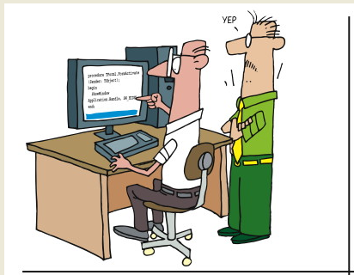
Hygiene
Notes:
Regarding hygiene, please be considerate to your neighbor.
This is not just an agile concept.
Which brings us to …….
[CLICK]

Slide 89
Write a Story
Preparation
Arrange yourselves into pairs
Objective
Each pair will write a short story based on the requirements on the instruction sheet
During each turn, one member of the pair will write, while the other member will ensure the requirements are being adhered to

Slide 90
Refactoring

Slide 91
“In software engineering, ‘refactoring’ source code means improving it without changing its overall results, and is sometimes informally referred to as ‘cleaning it up’. Refactoring neither fixes bugs nor adds new functionality, though it might precede either activity. Rather, it improves the understandability of the code, changes its internal structure and design, and removes dead code.
“These changes are intended to make the code easier to comprehend, more maintainable, and more amenable to change. Refactoring is usually motivated by the difficulty of adding new functionality to a program or fixing a bug in it.”
http://en.wikipedia.org/wiki/Refactoring
Notes:
Refactoring is another of the key development practices in Agile.
Let’s start with our definition:
“In software engineering, ‘refactoring’ source code means improving it without changing its overall results, and is sometimes informally referred to as ‘cleaning it up’. Refactoring neither fixes bugs nor adds new functionality, though it might precede either activity. Rather, it improves the understandability of the code, changes its internal structure and design, and removes dead code.
“These changes are intended to make the code easier to comprehend, more maintainable, and more amenable to change. Refactoring is usually motivated by the difficulty of adding new functionality to a program or fixing a bug in it.”
http://en.wikipedia.org/wiki/Refactoring

Slide 92
Practically Speaking.. What is Refactoring?
A series of small steps, each of which changes the program’s internal structure without changing its external behavior
Verify no change in external behavior by
Testing
Being very, very careful
Notes:
A series of small steps, each of which changes the program’s internal structure without changing its external behavior
Verify no change in external behavior by
Testing
Being very, very careful

Slide 93
The Need for Refactoring

Slide 94
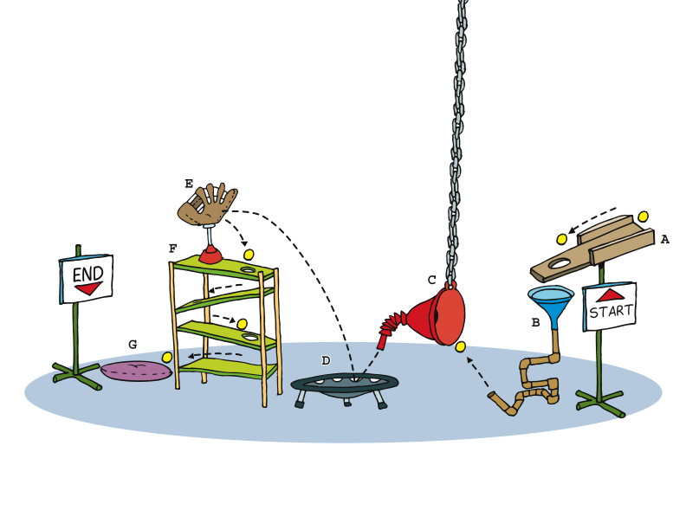
Refactoring 3
Notes:
Refactoring is about making it cleaner, more understandable, more maintainable.
Classically, software grows and grows, accreting more layers and complication and cruft as time goes on. This is sometimes referred to as topsy-ware, from the character Topsy, A "ragamuffin" young slave girl in the novel “Uncle Tom’s Cabin”. When asked if she knows who made her, she professes ignorance of both God and a mother, saying "I s'pect I growed. Don't think nobody never made me.”
Too much software just growed.
In nautical terms, the accretion might be thought of as barnacles, and refactoring as the process of scraping off the barnacles so that the boat can flow smoothly through the water.
Consider the process in front of you. What is its purpose? It seems to be intended to get the ball from the Start at point A to the End at poing G, right? Simple.

Slide 95
Why Refactor
To make room for new functionality
To make the program easier to change
To make the software easier to understand
To “Fix broken windows”
Notes:
To make room for new functionality
Getting ready for structural change
To make the program easier to change
Remove duplication
Put behavior in the right place
To make the software easier to understand
Express intent
Understand unfamiliar code
To “Fix broken windows”
The Pragmatic Programmers
A broken window.
One broken window, left unrepaired for any substantial length of time, instills in the inhabitants of the building a sense of abandonment—a sense that the powers that be don’t care about the building. So another window gets broken. People start littering. Graffiti appears. Serious structural damage begins. In a relatively short space of time, the building becomes damaged beyond the owner’s desire to fix it, and the sense of abandonment becomes reality.

Slide 96
When to/not to Refactor
Refactor when…..
Adding functionality
Fixing a bug
Doing a code review
Consider not refactoring when….
Code is too messy (better to start over)
Near a deadline

Slide 97
Good coding practices
Express Intent
Once and Only Once (a.k.a DRY)
Notes:
Not having these are smells.
That require refactoring.
If done well initially, good coding practices.
There are many more.
YAGNI (You aren’t gonna need it)
SOLID

Slide 98
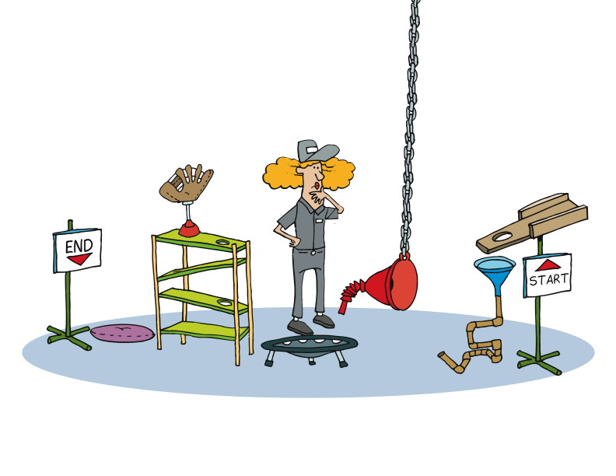
Express Intent
Notes:
Express Intent - Meaning your code should be named in such a way that it reflects what it is to do.
----------------------------------------------------------------------------------------------------------------
When we refactor code, we first begin by considering what it is supposed to do. Not only what it is supposed to do, but also what other pieces of code expect it to do.
If in the process you see, there is another process that accepts the ball coming out of the End point, then that End point must remain the same, and the ball must still come out there.
Does that process care how the ball got from A to G? No.
Do you care how it gets from A to G? Well, yes, you do. You care that it will be clear and as obvious as possible and as maintainable as possible, so that whoever comes after you to work on the code can do so quickly.

Slide 99
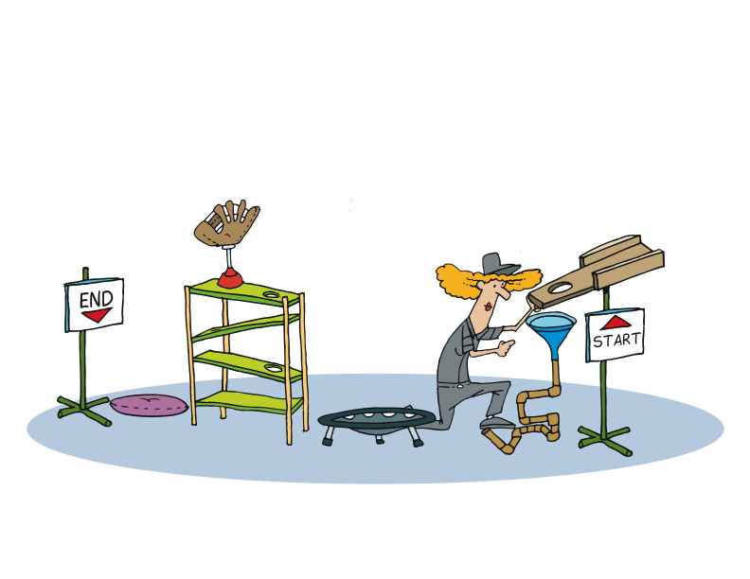
Once and Only Once
Notes:
Once and Only Once (aka. Don't Repeat Yourself or D.R.Y.) - Meaning that as code is identified that does the same thing as other existing code, that is a refactoring opportunity.
----------------------------------------------------------------------------------------------------------------------
So you’ll consider each element of the code you’re examining, and decide whether that element is necessary, whether the parts are reasonably named, whether there’s a more effective and efficient way to accomplish the same thing, without changing the Start or the End in any way.
In code, you might find that you’ve used the same code in multiple places, because you kept copying and pasting as you worked.
In Agile, we have an acronym: DRY (that’s dee-are-why), which stands for Don’t Repeat Yourself. It’s a guideline for refactoring. If you have copied code, there’s a smell. The cure for that smell is to move the code into a function or method, and then only reference that function or method.
Why? Because copied code means that if you make a change to one, you have to make changes to all the copies. That’s inefficient and expense, and prone to errors. If you move the code into a single location, then you eliminate that issue.

Slide 100
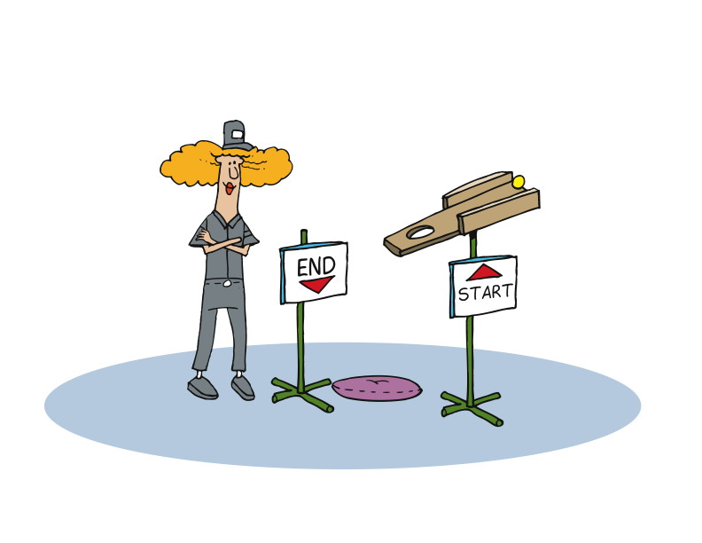
What about ownership?
Notes:
Agile teams avoid personal code ownership and encourage team ownership.
Not my code
Not your code
Part of a product we are building as a team
Each has a responsibility
To produce code easy for others to figure out and work on
We do focus on personal commitment
-------------------------------------------------------------------------------------------------
That last point deserves a little extra attention.
On Agile teams, we avoid personal ownership and encourage team ownership. That means that the code I write is not my code. It’s just code that I wrote as part of our team effort to produce something. And it means that the code you wrote is not your code, but code that is part of the product we’re building that we all own.
Each of us commits to trying to produce code that is easy for others to figure out and work on.
So while we avoid personal ownership and focus on team ownership, we also focus on personal commitment as well as team commitment.
To paraphrase Mr. Spock of Star Trek fame, The Ownership of the Many Must Outweigh the Ownership of the Few or the One, but the commitment of the one is necessary for the commitment of the many.

Slide 101
Refactoring and the TDD Cycle
2. write code
3. refactor
Test Fail
Test Pass
1. write test
Notes:
Remember TDD?
I’ve got a new bug or feature that I am working on.
After reviewing the code we will be working on, my pair and I consider refactoring.
Refactoring is an active part of the TDD method and you always write tests on what you’ve just refactored.

Slide 102
Refactoring versus Redesign
Refactoring - key part of modern software development practice –don’t need permission
Redesign - Large scale refactoring/redesign decisions should be owned by the whole team
Notes:
You should not need permission to refactor
it is a key part of modern software development practice
you don't need to tell your manager
Large scale refactoring/redesign decisions should be owned by the whole team
redesign requires courage
discuss with the entire team
the team needs to have a shared ownership and a common understanding of what needs to be done

Slide 103
Incremental/Emergent Design
Incremental and continuous (not “Big Design Up Front”)
Simple design (not poor design)
Depends upon refactoring
Follows same pattern as TDD
Avoid YAGNI (You ain’t gonna need it)
Notes:
Three parts:
Create simplest design that could possibly work
Incrementally add to it as software evolves
Improve the design (refactor)
First design element should be specific (not abstract, as might be tendency).
Second: More general, but only enough to include both elements
Third: Further minimally generalize.
Limit refactoring to only your current design.

Slide 104
Team practices
Encourage refactoring culture
Provide sound testing base
Shared Code Ownership
Notes:
Encourage refactoring culture
Nobody gets things right first time
Refactoring is forward progress
Provide sound testing base
Tests are essential for refactoring
Build system and run tests continually
Shared Code Ownership
You should be free to refactor any part of the system

Slide 105
Generalization and Specialization
Notes:
In talking about pairing and refactoring, we mentioned the idea of team ownership and individual and team commitment.
This relates to the ideas of generalization and specialization.
For the purposes of our discussion, we’ll define specialization as the localization in an individual or group of specific knowledge or skills.
And we’ll define generalization as the distribution of both knowledge and skills amongst a group or population, and as individuals having broad sets of skills and knowledge that can be applied to multiple situations.

Slide 106
Definitions
specialization
the localization in an individual or group of specific knowledge or skills.
generalization
the distribution of both knowledge and skills amongst a group or population, and as individuals having broad sets of skills and knowledge that can be applied to multiple situations.

Slide 107
The Waterfall Way: Specialization
Notes:
Let’s look at the Waterfall way, which is specialization.

Slide 108
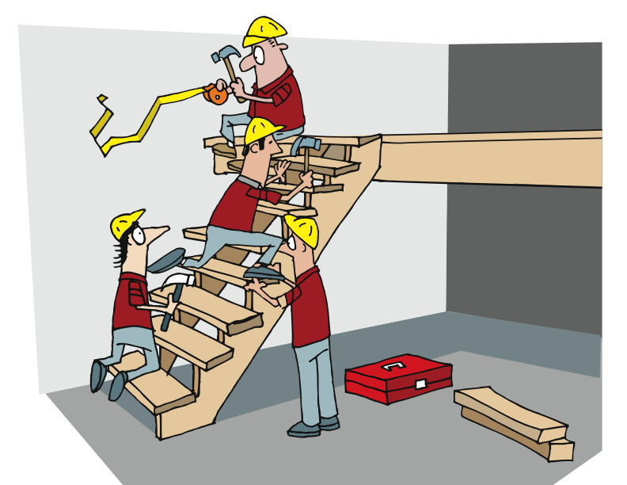
Generalization and Specialization 1
Notes:
Vertical specialization – domain. The shopping cart through the database and into access control.
Horizontal specialization – layer. Presentation, data, web services
“Talk to Tom, he’s the db guy”
“Susan handles everything to do with the shopping cart”
Let’s consider a typical waterfall project. There will typically be specialists, and those specialists will fall into one of two categories: vertical specialization or horizontal specialization.
Vertical specialization deals with the domain: expertise on the shopping cart or on the access control and security system. These things span all the layers and levels of the application, from the database through the business logic to the presentation layer. That’s why we refer to it as “vertical”.
Horizontal specialization deals with a particular layer or tier of the application or system: expertise with database, web services, or the presentation layer, for instance. These things span all the vertical areas, which is why we refer to it as “horizontal”.
Thus we have cross-cutting areas of specialization. We frequently find both kinds of specialization on teams, resulting in comments like “You need to talk to Tom – he’s the database guy” or “That would be Susan’s area – she handles everything to do with the shopping cart.”
When things are working optimally, everything is great.

Slide 109
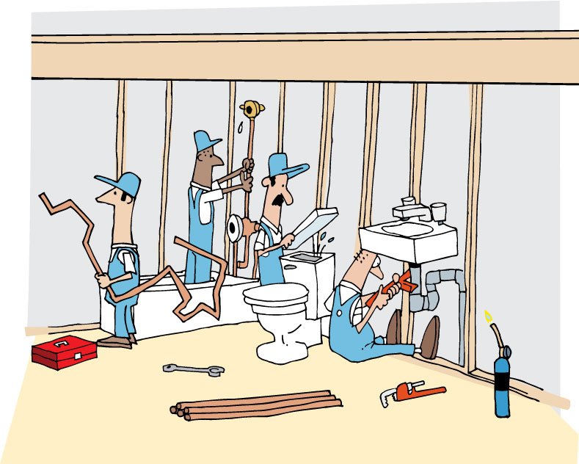
Notes:
When everyone is in one room and accessible its OK
Each specialist group or individual does their thing. They bring their expertise to bear, making sure that they fulfill their obligations and meet expectations.

Slide 110
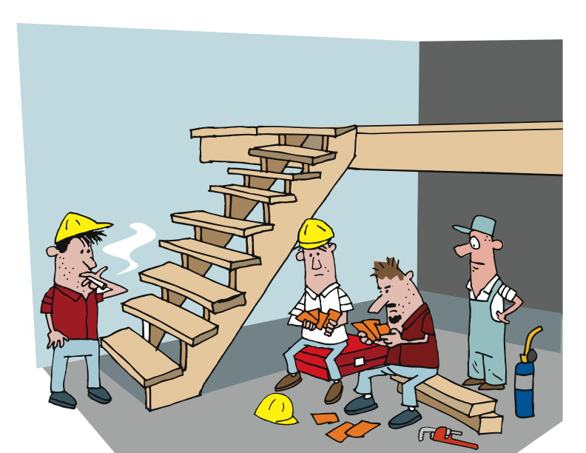
Ready for testing…
Notes:
But what happens when one of these specialties becomes a bottleneck?
--------------------------------------------------------------------------------------------------------
In this example, the work of the two specialty teams is done, and they are dependent on a third specialist to proceed.
They can’t really start on anything else until this phase is completed because that’s the way the project plan is laid out.

Slide 111
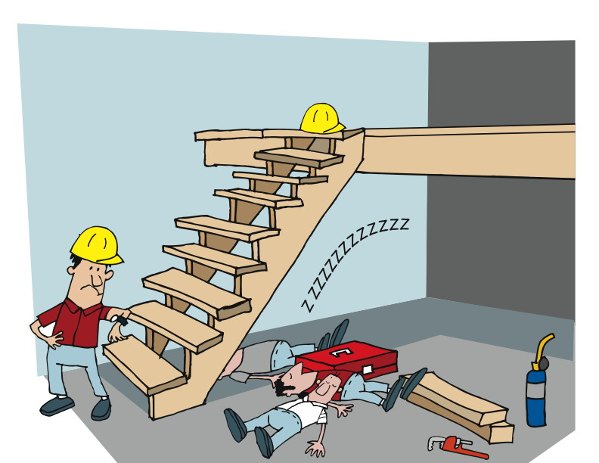
Notes:
So they wait. They’ll find other things to do if they can, but they wait.
And, in the meantime, the schedule is slipping, the costs are growing, and the customer is getting impatient.

Slide 112
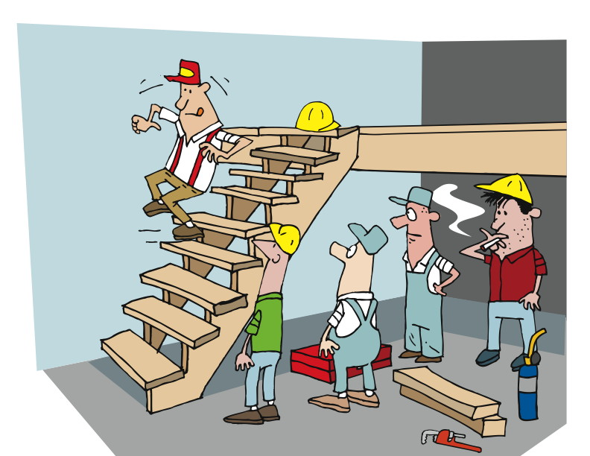
And finally…
Notes:
Ultimately the bottleneck is passed when the required specialist gets his or her work done.

Slide 113
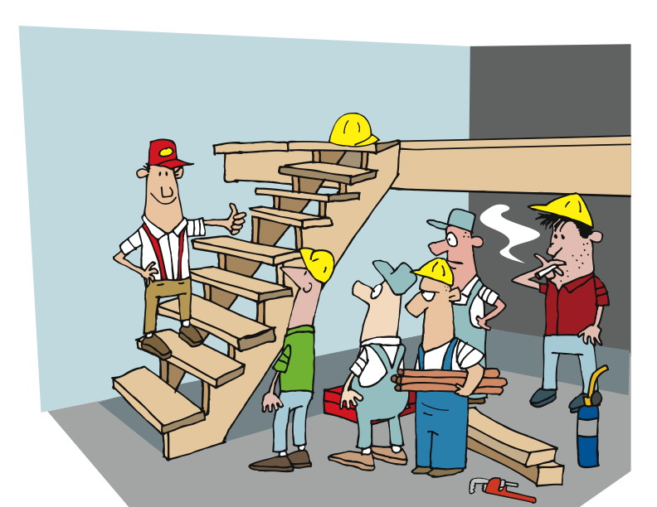
Test Passed!
Notes:
And everyone can move on.

Slide 114
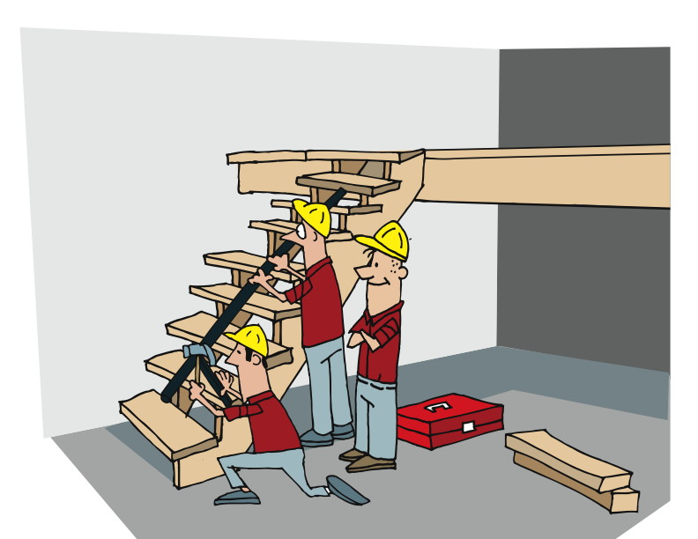
Finishing the work, at last
Notes:
Everyone gets back to work but time is lost
In one project team we’ve worked with, their QA was all done manually. That means that at each iteration, their QA team – one person – would first perform his regression testing. That means that he would execute all the scripts he’d developed thus far, making sure that nothing was broken. Then he’d write and execute new scripts to verify all the new features and bug fixes produced in the current iteration.
A smell? You bet! First of all, in spite of the fact that his team said that they were working on two week iterations, the reality was that they were four week iterations because it took the QA guy another two weeks after the development team was done. Until he finished his QA work, the iteration really wasn’t done.
Then there’s the fact that there was no test automation being done. But that’s a topic for another module. We’ll get back to that later.

Slide 115
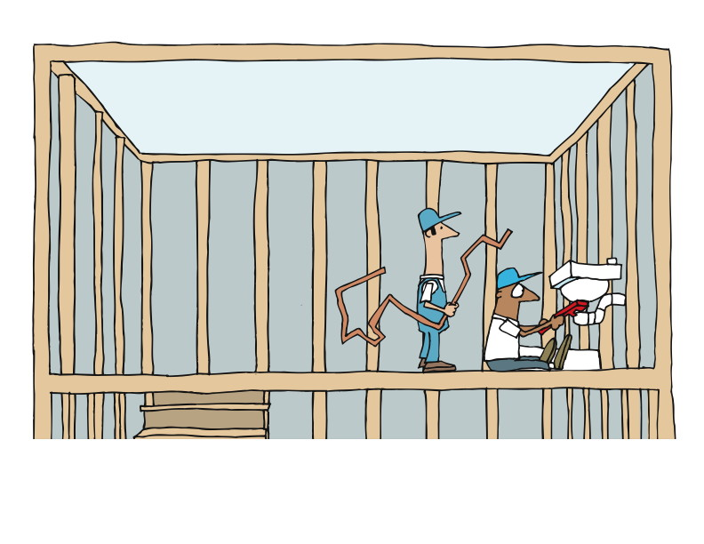
Generalization and Specialization 8
Notes:
Generalization and collaboration vs specialization and bottlenecked and fragile
So as you can see, the challenge with specialization is that everything can become single-threaded, bottlenecked, and very, very fragile.
If you’ve worked on a Waterfall project, it’s almost certain that you’ve run into a situation like we’ve discussed here, watching the schedule slip and the costs go up, and listening to someone higher up in the organization asking when it’s going to be done and why it’s costing so much.
Right?

Slide 116
The Agile Way: Generalization and Collaboration
Notes:
No doubt, by now it has become obvious that Agile teams operate differently than Waterfall teams.
One of the hallmarks of effective and performant Agile teams is some degree of generalization and a high degree of collaboration.

Slide 117
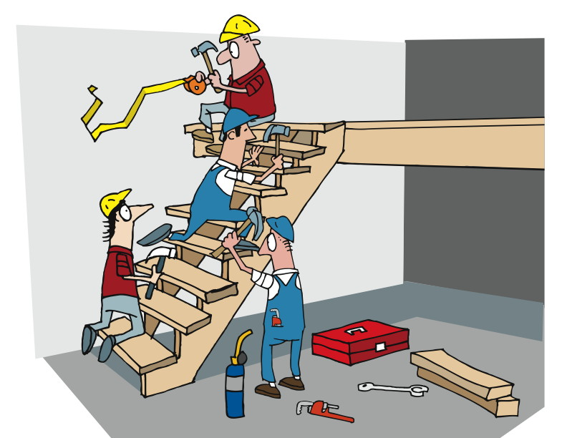
Notes:
With a goal to eliminate bottlenecks
Team members are encouraged to continually add to their base skills and expertise
Do that through –
Pairing
Collocation
Osmotic learning
Or
[CLICK]
-------------------------------------------------------------------------------------------------------------------
While we expect team members to have different areas in which they have greater expertise and skill than other team members, we also expect them to be continually adding to their based of skills and expertise.
As we’ve discussed earlier, one of our goals is to reduce or eliminate delays and bottlenecks that arise from dependency on specialists.
So we try to have everyone learn something about all parts of the application or system, and learn something about all of the technologies, layers, and tiers. We do this through a combination of things: collocation, pairing, open communication, osmotic learning, and information radiators.
Some of these we’ve already discussed, some are being covered in this module, and some will be covered in later modules.

Slide 118
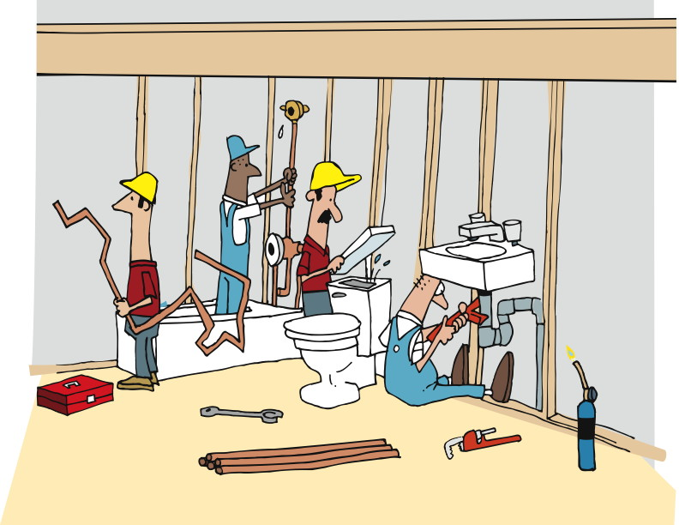
Notes:
At least make sure all necessary roles are represented in the team room or accessible
QA, Dev, BA
-------------------------------------------------------------------------------------------------------------
In a Waterfall team, typically tasks are assigned to team members by the project manager. That means that when the project manager – a specialist – is unavailable, it’s possible for someone to have nothing to do.
In a Waterfall team, when something needs to get done and the appropriate specialist is unavailable, it can have a ripple effect in time delays and cost increases.
On an Agile team, the expectation is that when there is a story to be worked on, any member or pair on the team can sign up for the story and work on it.
On an Agile team, when a bug needs to be fixed, it is expected that any member or pair can work on and fix that bug, regardless of who wrote the original code. And, as we discussed earlier, it’s not anyone’s personal code, and it’s very possible that more than one person or pair has already worked on that code.

Slide 119
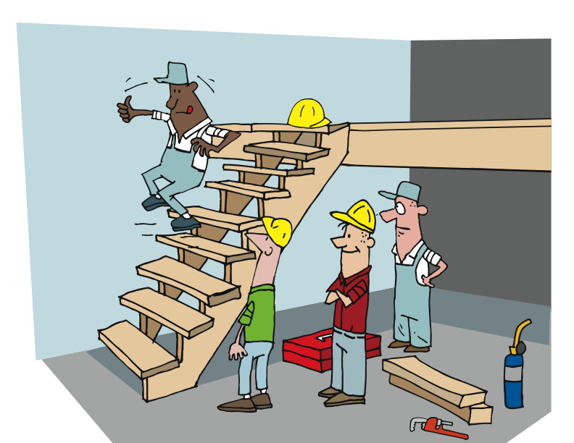
Notes:
BAs can test
Devs can test
Devs can do DB work
Middle ware folks can do
Devs and QA can pair on testing or development
Specializations -
Developers, testers, business analysts
Specific programming languages and environments
Technologies, like database, web services, presentation layer, reporting
Functional testing, ui testing, integration testing
Architects, designers, developers
Project leads, project managers, product owners
User interface, user experience
--------------------------------------------------------------------------------------------------------------
While we still identify roles such as QA and BA (that is, quality assurance and business analyst), and recognize that there are specific QA skills and BA skills, on an Agile team we do what we can to spread those skills and responsibilities around.
If all the developers know how to do QA, then the distinction between individuals as Developer versus QA start to fade. It means that when something needs doing, the odds are that there is someone who can do it.
It’s not unusual for members of an Agile team to shift between doing Development and doing QA, or to see a QA pairing with a Developer, whether they are working on development or testing.

Slide 120
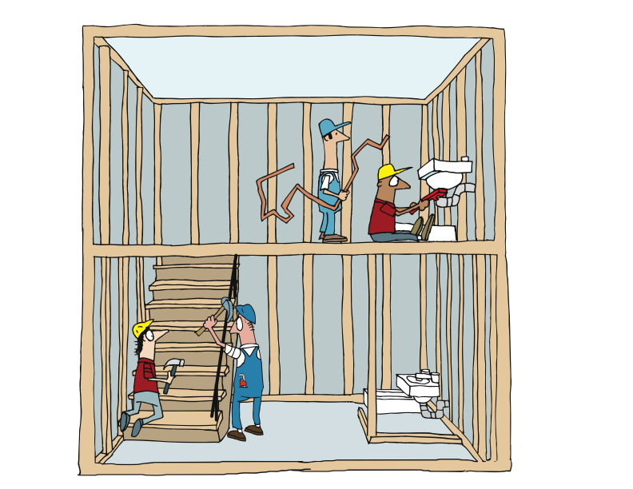
Generalization and Specialization 12
Notes:
One of the most difficult practices to embrace for a large organization.
Takes commitment and a mind shift.
None of this is to say that there are no specialists on Agile teams. There will always be people who know more about one area than others do. There will always be circumstances in which it makes sense to separate the ROLES of Developer and QA and BA.
However, the more we distribute the skills and expertise, the more choices we have and the more likely we are to keep the project flowing.

Slide 121
Integration the Waterfall Way
Notes:
Next up on our agenda is Integration.
Our definition:
In engineering, system integration is the bringing together of the component subsystems into one system and ensuring that the subsystems function together as a system. In information technology, systems integration is the process of linking together different computing systems and software applications physically or functionally.

Slide 122
In engineering, system integration is the bringing together of the component subsystems into one system and ensuring that the subsystems function together as a system. In information technology, systems integration is the process of linking together different computing systems and software applications physically or functionally.

Slide 123
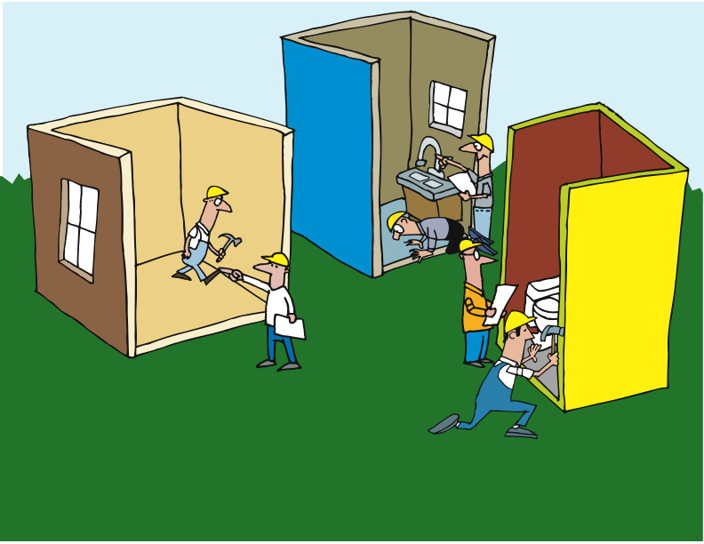
Notes:
Each project or subsystem working in isolation from the others.
Some communication, but not enough.
Limited to integration specific discussions.
Tested loosely until the parts are integrated as a whole.
---------------------------------------------------------------------------------------------------
In a Waterfall world, each project or subsystem team works mostly in isolation from the others. There will likely be some communication between the teams, but generally speaking each team specializes in the part they’re building, and only talks to the others when they need to discuss an interface.
Testing of the interfaces is likely to be done loosely, as it is believed that the most effective testing will be done when the parts are integrated into the whole.

Slide 124
Notes:
Of course, there are problems with this. They can be as simple as getting the data type wrong for an argument, and as complex as transformations that are applied to data within one subsystem that make it incompatible with another.
The biggest problem, of course, is that the teams do ALL the work before ever trying to bring things together.

Slide 125
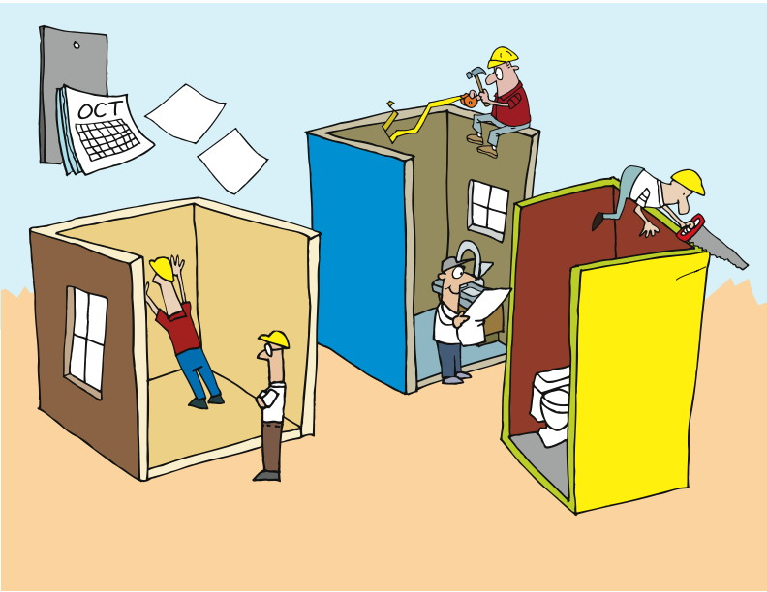
Notes:
Which means that we have the same problem we had when we talked about pairing and catching defects early: rework.
When you’ve built the whole thing, and then have to go back and figure out where the problems are and who should fix which and how, well, it just gets complicated and costly and time-consuming.

Slide 126
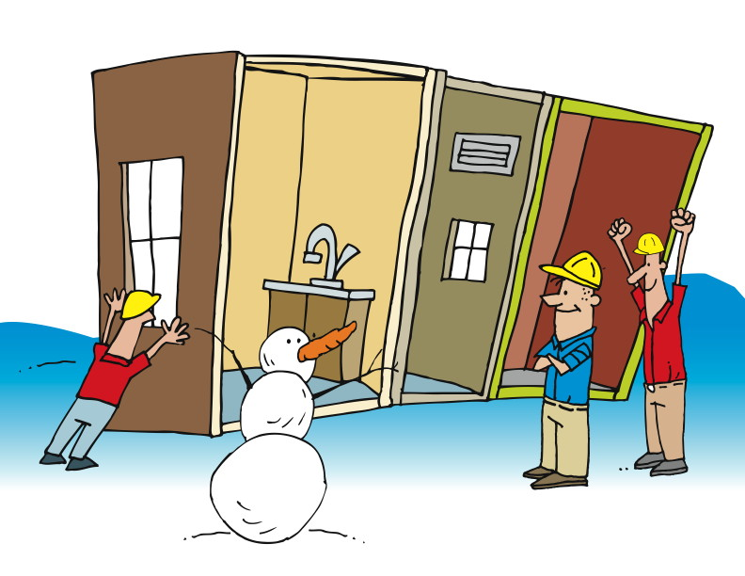
Eventually…
Notes:
Ultimately, the team may meet with success. But along the way, the pain is shared by everyone.

Slide 127
The Agile Way: Continuous Integration
Notes:
An approach that has been adopted successfully on Agile teams, and is making its way onto teams of all kinds, is Continuous Integration. This is a term that was originally described in a blog post by [CLICK] Martin Fowler in September of 2000.
“Continuous Integration is a software development practice where members of a team integrate their work frequently, usually each person integrates at least daily - leading to multiple integrations per day. Each integration is verified by an automated build (including test) to detect integration errors as quickly as possible. Many teams find that this approach leads to significantly reduced integration problems and allows a team to develop cohesive software more rapidly.”
http://www.martinfowler.com/articles/continuousIntegration.html

Slide 128

“Continuous Integration is a software development practice where members of a team integrate their work frequently, usually each person integrates at least daily - leading to multiple integrations per day. Each integration is verified by an automated build (including test) to detect integration errors as quickly as possible. Many teams find that this approach leads to significantly reduced integration problems and allows a team to develop cohesive software more rapidly.”
http://www.martinfowler.com/articles/continuousIntegration.html
Notes:
Read the slide.

Slide 129
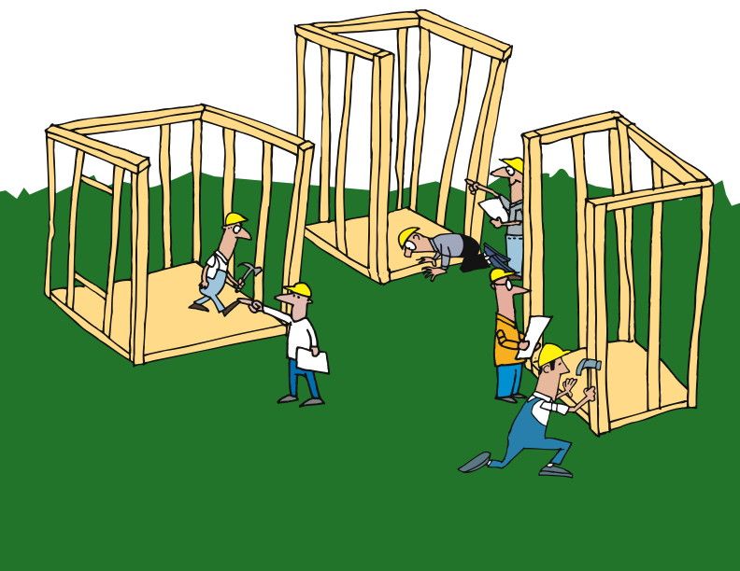
Independent Action
Notes:
We’ve got separate teams working on separate parts
We may be able to rotate personnel, but maybe not
------------------------------------------------------------------------------------------------------------------
Let’s consider the same scenario we discussed a minute ago.
We have separate teams, each of which is working on a piece – a class, a subsystem, a system, whatever it is – that is intended to connect and work with the other parts.
There’s really no functional alternative to having focused teams. While it’s possible to rotate personnel between teams, it’s likely that the disruption would be too great to justify the practice.
So we’ve got separate teams working on separate parts.

Slide 130
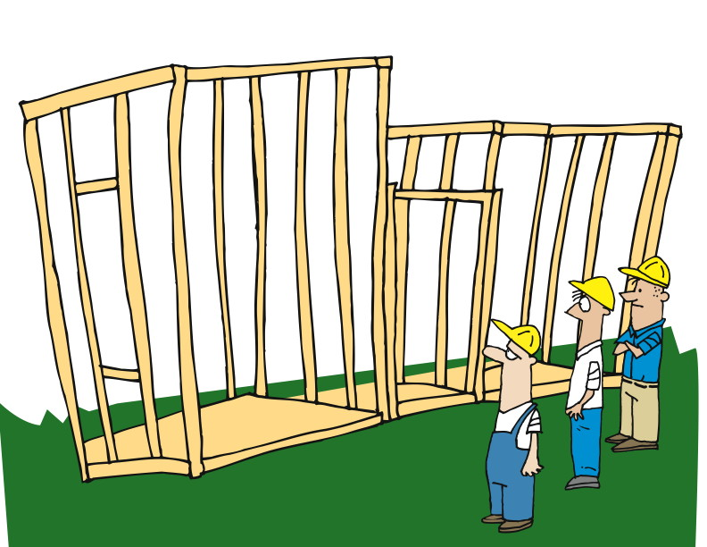
Check and Fail Early
Notes:
Continuous Integration incorporates short cycles to identify issues early
Failing fast, fail early does not mean we want to fail
It means find the failures as early as possible to reduce cost
A joke in chicago on election days is “Vote early, vote often”. Integrate early, Integrate often.
The big difference with Continuous Integration is that we incorporate short cycles so that we can identify issues as early as possible.
In the Agile world, we talk about failing fast or failing early. This is sometimes misunderstood to mean that we are hoping to fail or planning to fail. That’s not so. What we are doing is acknowledging that failures will occur, and hoping to find them as soon as possible to minimize their total impact.
One of the most important tools in this approach is continuous integration.
At regular – and short – intervals, we bring everything together to see if what we’ve done so far all works well together.

Slide 131

Check
Notes:
Check and test regularly
CI processes may run every time someone checks in code
Full suite of tests run against the code
Remember TDD
Builds take too long. There are ways to address this.
Rather than waiting until we’re all done – or at least, we THINK we’re all done – we do our checking and testing and integrating on a regular basis.
In fact, depending on your circumstances, it’s pretty common for development teams to set up the continuous integration process to run every time someone checks in code. That means that a full suite of tests is run against the code every time someone makes a change.
Don’t forget about our earlier discussion of Test-Driven Development. We embrace the practice of writing tests for all of our development, so that test base grows every time code is checked in too.
Of course, at some point, it starts to take too long to run ALL the tests every time someone checks in code. There are solutions to this, which are beyond the scope of this module. Suffice it to say that others have run into this problem, and have taken steps to address them. In fact, Cruise, the continuous integration server from ThoughtWorks Studios, was specifically designed to address this from day one.

Slide 132

Adapt / Do
Notes:
Plan, Do, Check, Act continuously
------------------------------------------------------------------------------------------------
By embracing continuous integration – compiling, linking, loading, testing, and deploying – on an ongoing basis, we have a much better chance of failing early and finding and fixing problems when the cost is at its lowest.
As we follow the PDCA (remember that that stands for Plan, Do, Check, Act) cycle, we are continuously finding and fixing problems, and responding to situations close to when they occur.

Slide 133

Notes:
That cycle of rapid and timely feedback allows us to make changes and corrections early.

Slide 134

Notes:
And because we do this on an ongoing basis…

Slide 135

Notes:
Working software at the end of each iteration.
We are checking for and finding problems much earlier, so that we are fulfilling one of the principles of Agile: working software at the end of each iteration. Rather than waiting months or years to be able to see and use the software under development, we are using continuous integration to make sure that all of our parts work, and that they work together.

Slide 136

Notes:
And by using a combination of regression tests and deployment testing, we get away from the common developer assertion that “it works on MY box!”

Slide 137

Notes:
Since we’re testing on a build server – or maybe on multiple servers – and testing the deployment as we go, we reduce the number of surprises we receive at the end.

Slide 138
Module Showcase
Be able to recognize smells
Understand how we “bake quality in” to the agile project
Understand the use of acceptance criteria
Understand the role of automation
Understand how and why we pair
Define refactoring and why it is done
Learn about test-driven development
Understand the role of continuous integration
Notes:
We’re almost at the end of this module. Just a quick review now, and we’re done. [CLICK]
At the beginning, we talked about doing unit testing first – that is writing tests before we write the code to be tested. And we talked a little bit about iterations. [CLICK]
Then we talked about smells, and how they signal that something is wrong, and give us a clue as to where to look. [CLICK]
Next we discussed refactoring, and how keeping the code clean and clear and effective and efficient is an everyday part of the developer’s job. [CLICK]
That took us to Generalization and Specialization, and our belief that spreading the knowledge and experience and skills around to the members of the team makes for stronger teams and better results. [CLICK]
And we just finished up with Continuous Integration.
It’s powerful stuff!

Slide 139
Questions?
Team Delivery Practices

